Slide 1
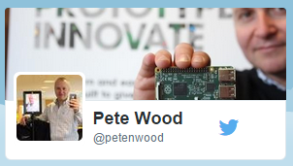
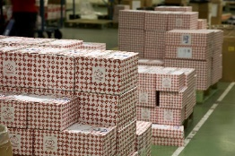
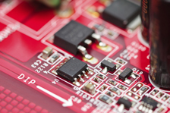
Supporting Engineers and Innovation
Pete Wood
RS Components
Who am I?
> 2,500 Major Suppliers
500,000 Products
> 1m Customers
> 44,000 Parcels Daily
Who are we?
£1.3B Revenue
The global distributor for engineers

Slide 2
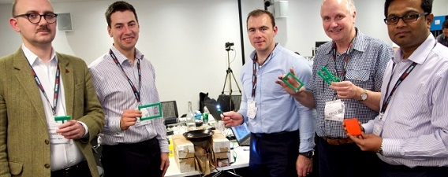
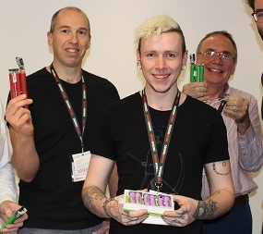
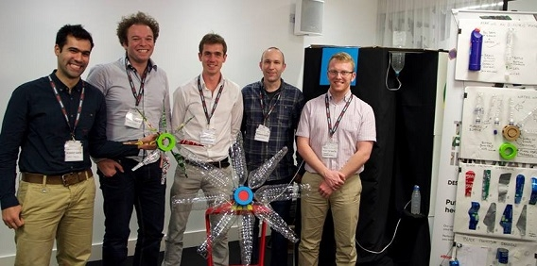
Supporting the Modern Engineer…
Supporting the Modern Engineer…
As engineers we understand that we;
increasingly face time pressures
Want to keep up new technologies and the skills required is our greatest challenge
We look for design ‘shortcuts’ to save time and counter lack of skills in a given area
When designing, Online is the predominant source for our information
Rich content, including video, product reviews, technical articles webinars, are becoming key in our product decisions
So, In 2010 we created a place where fellow Engineers/Hackers/Makers, could get easy
access to the tools and resources they needed to create awesome designs

Slide 3
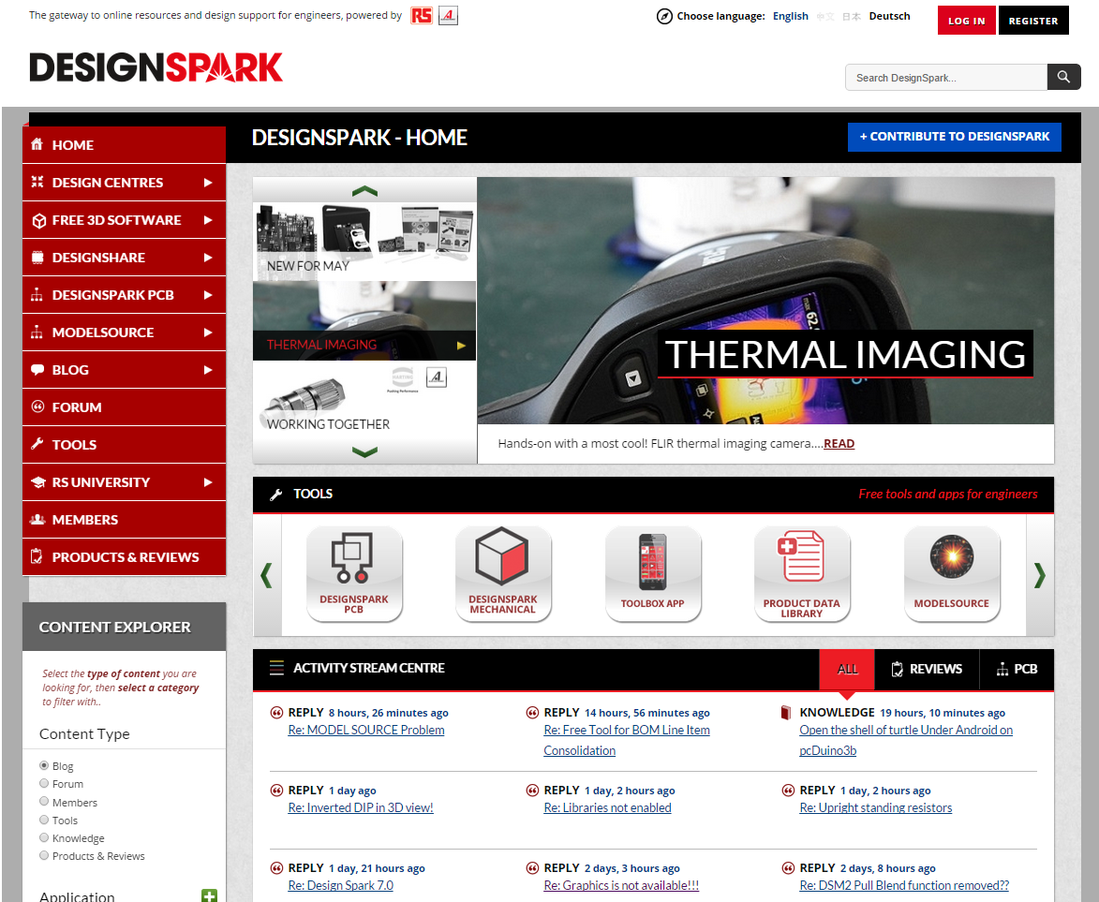
Our Engineering Community
Free Professional Applications
- PCB Design
- Mechanical CAD tools
- CAE Software
- Procurement Software
Design Shortcuts
- CAD & PCB Models
- Software code
- Open Source Reference designs & Projects
- Circuit Examples
Reference
- Technical Blogs & Articles inc Industry experts and influencers
- Product Reviews
- New Products & Technologies
- RS University Academic Content
Technical Support
- Support Forums
- Community (peer) support
- Video Tutorials
- Technical Articles
>300k members
In 200+ territories
10K New members/month
1M+ pageviews/month

Slide 4
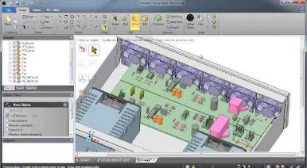
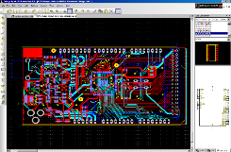
Our Design Software
Free of charge schematic capture & PCB layout software
Integrated model library
BOM & PCB Quote functionality
200k users globally
Standard tool for >120 elite Universities
Free of charge 3D design software
Direct Modelling methodology puts 3D design into hands of non-CAD specialists
Integrated 3D model library
Perfect for Designing Enclosures!
BOM quote functionality
160k users globally in 12 months
Reference tool kit for design engineers
Range of calculators, conversion tools and lookup tables
Datasheet database (version 2)
Translated into 16 languages
1.5k downloads every week

Slide 5
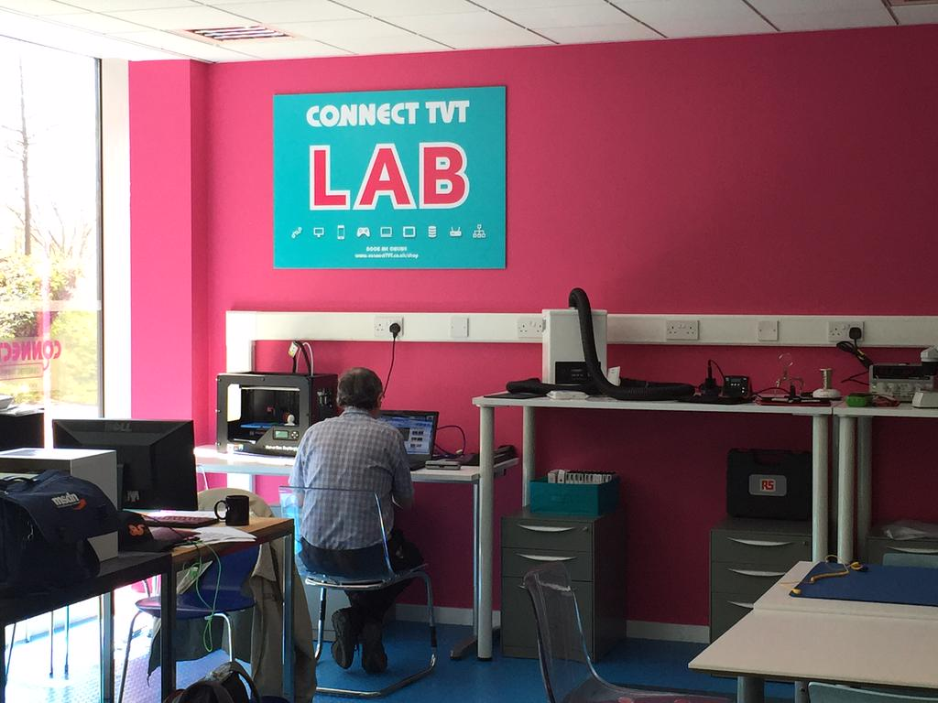
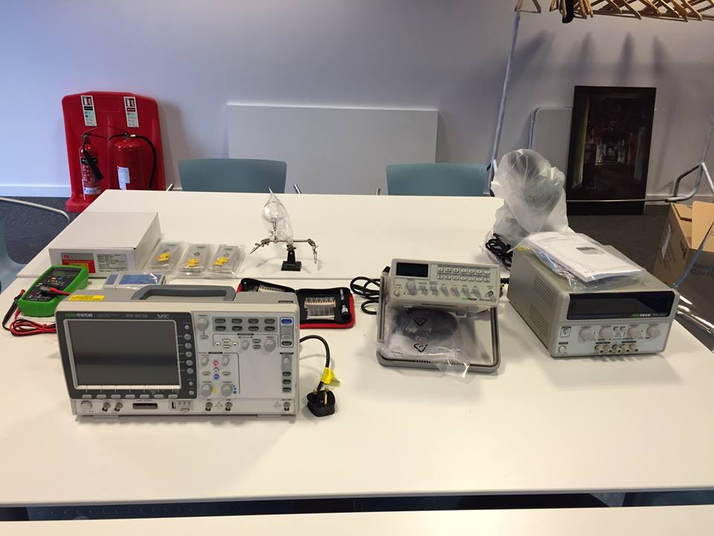
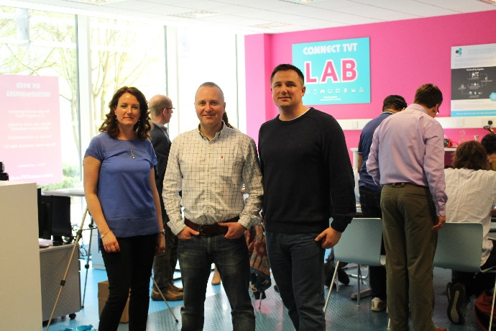
Supporting Tech Start-Ups
RS Components/DesignSpark have donated £5000 worth of Equipment
to help support Tech Start-Ups in the Thames Valley

Slide 6
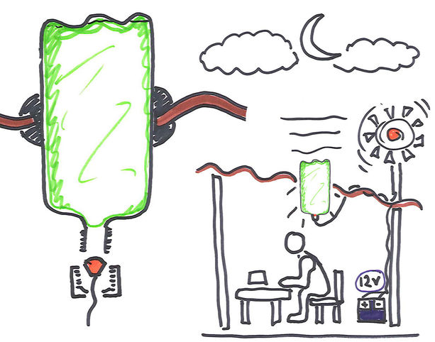
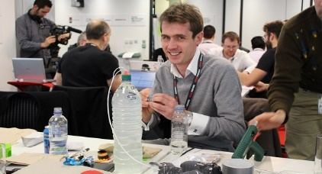
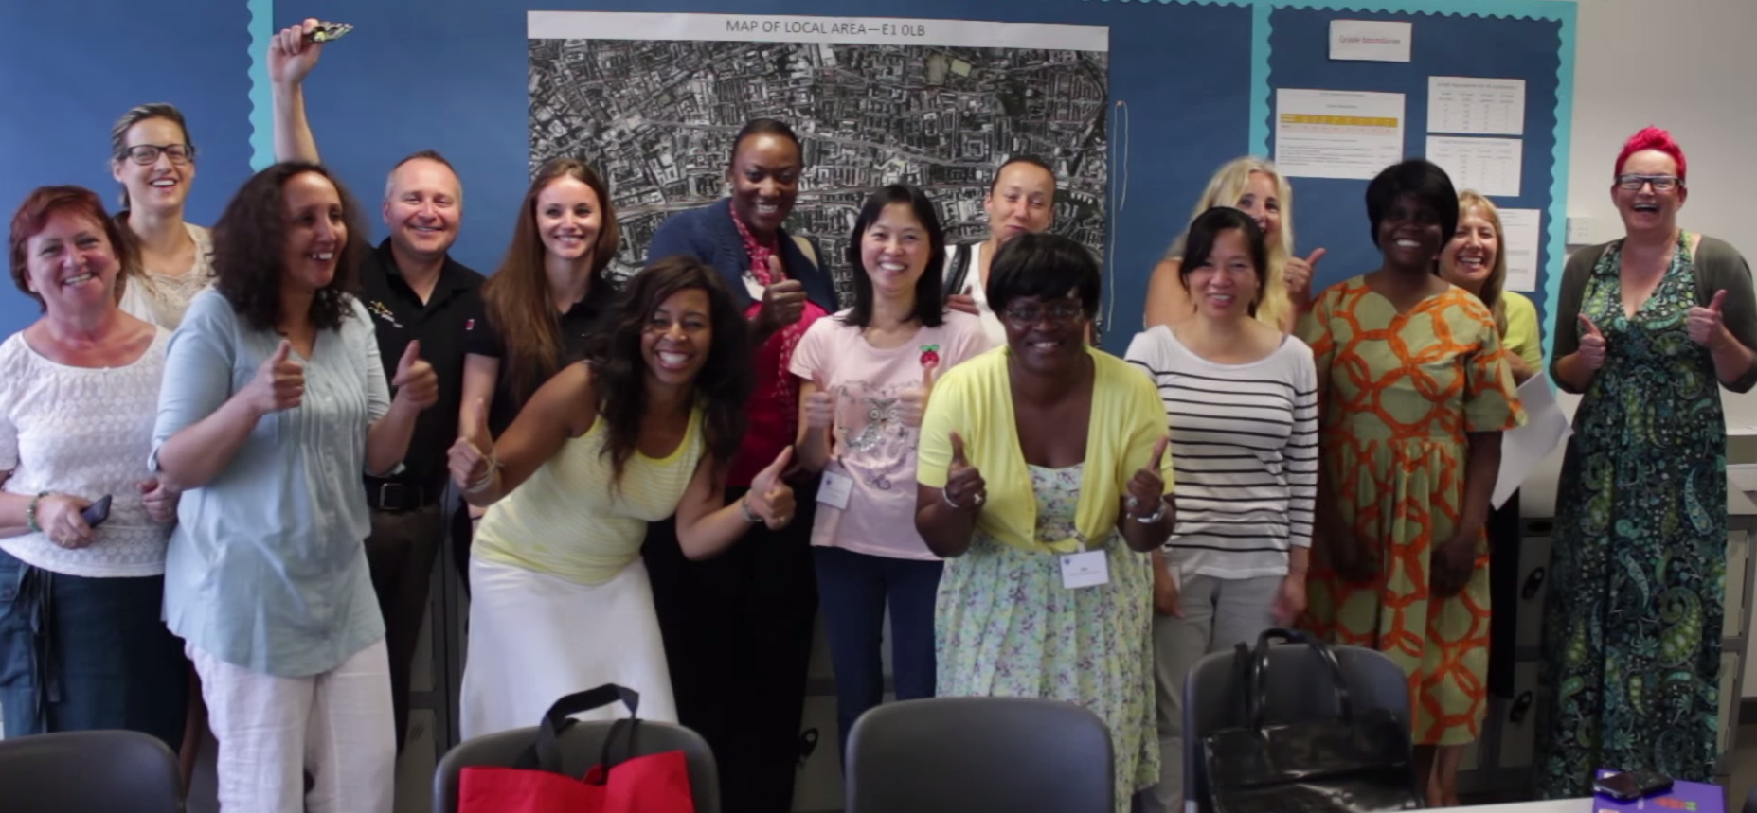
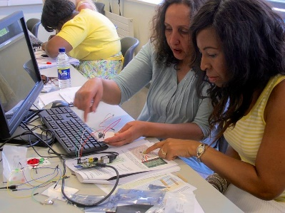
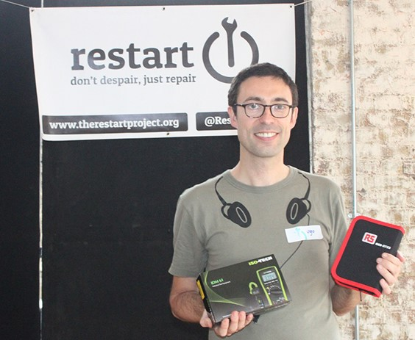
Supporting Good Causes
Hackathon - Brief to create a domestic electricity generator which is affordable and easy-to-produce in the 3rd world
Off-the-Grid Lighting Solution (LED Moser Light Evolution)
Hands on Workshops – Raspberry Pi’s + Code + Circuits
Helping the mums get hands on with technology, building their confidence and showing them what great opportunities are out there in the digital world
Sponsoring Restarter Workshops
Don’t through away your broken tech - Learn how to Repair it!

Slide 7
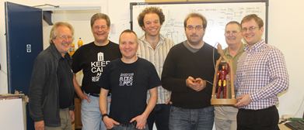
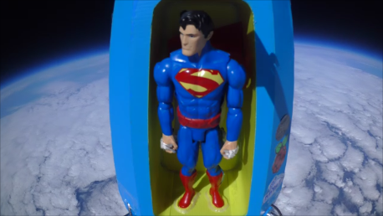
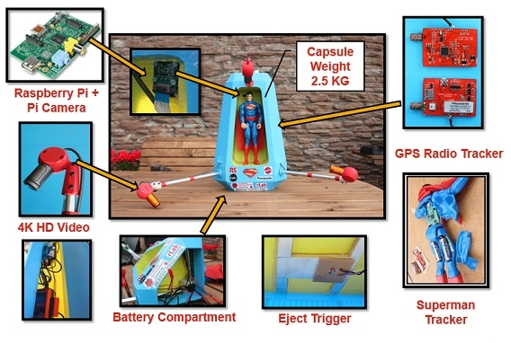
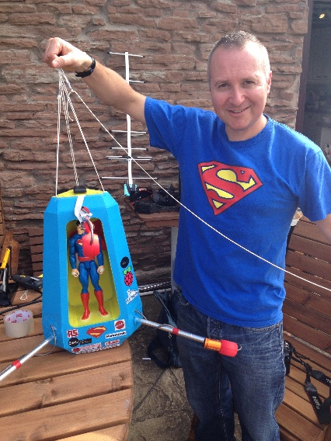
Fun Stuff…

Slide 8
It’s easy to join our community!
www.designspark.com

