Slide 1
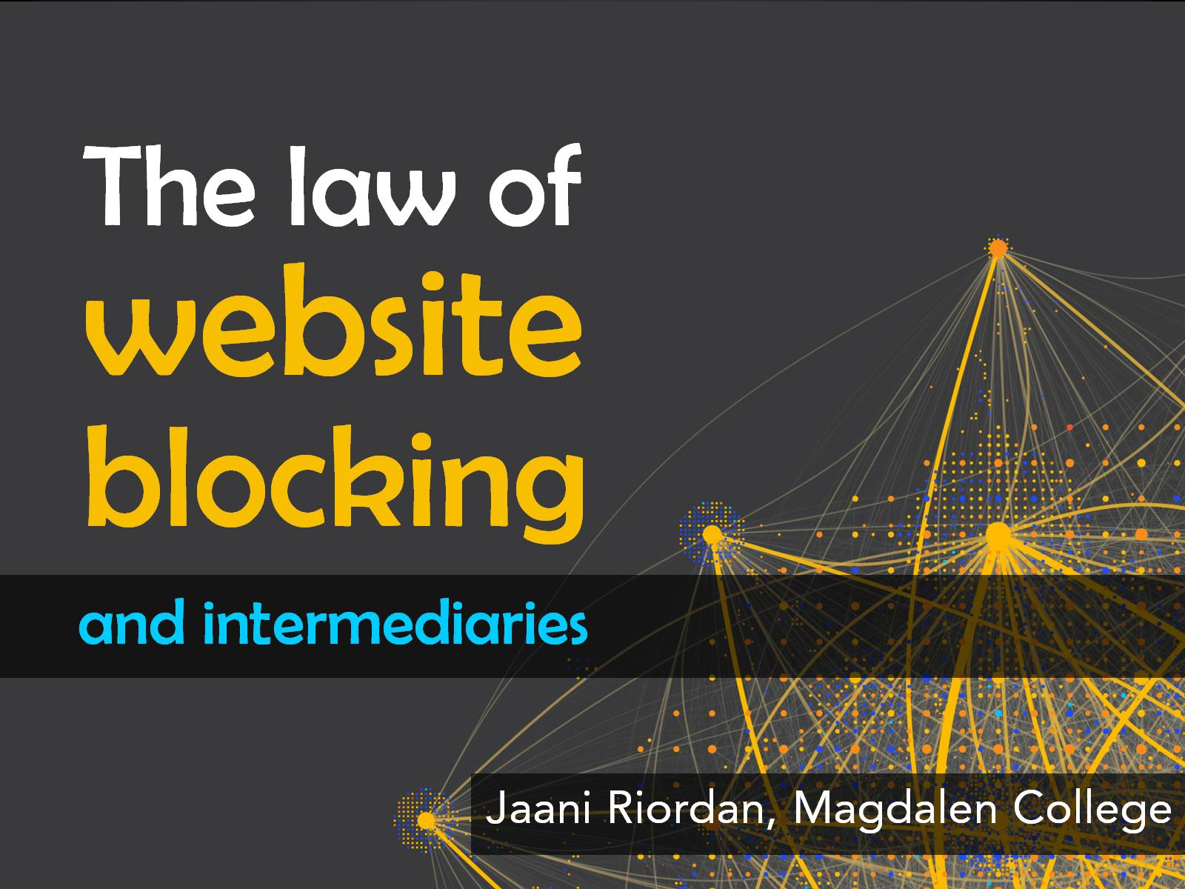
The law of website blocking

Slide 2


Slide 3


Slide 4
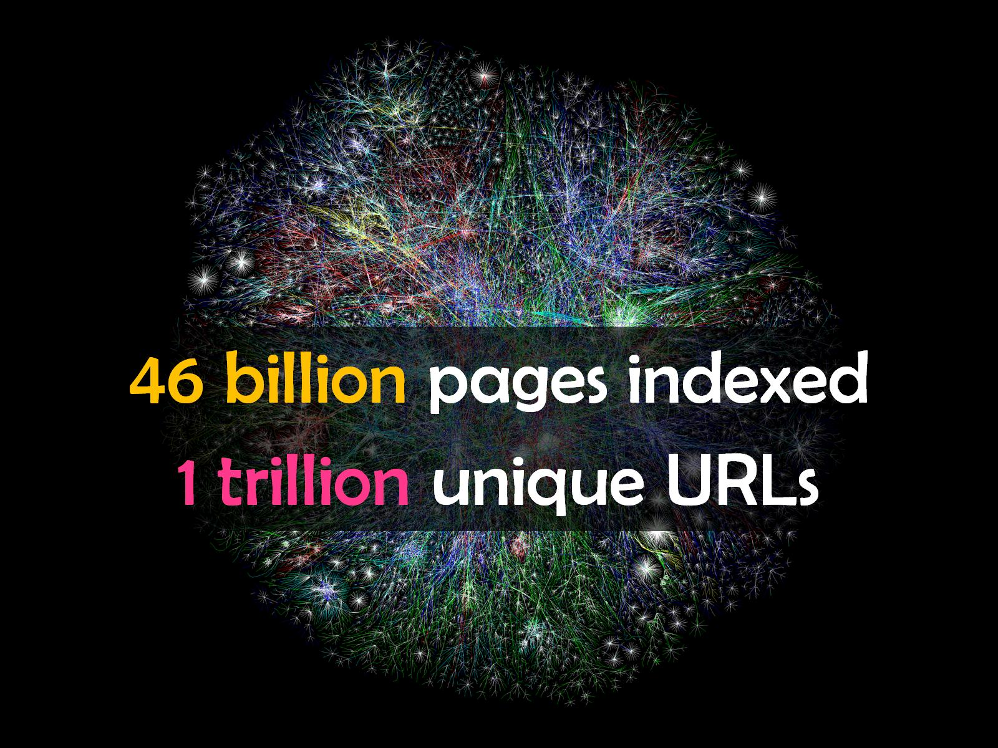

Slide 5


Slide 6


Slide 7


Slide 8


Slide 9
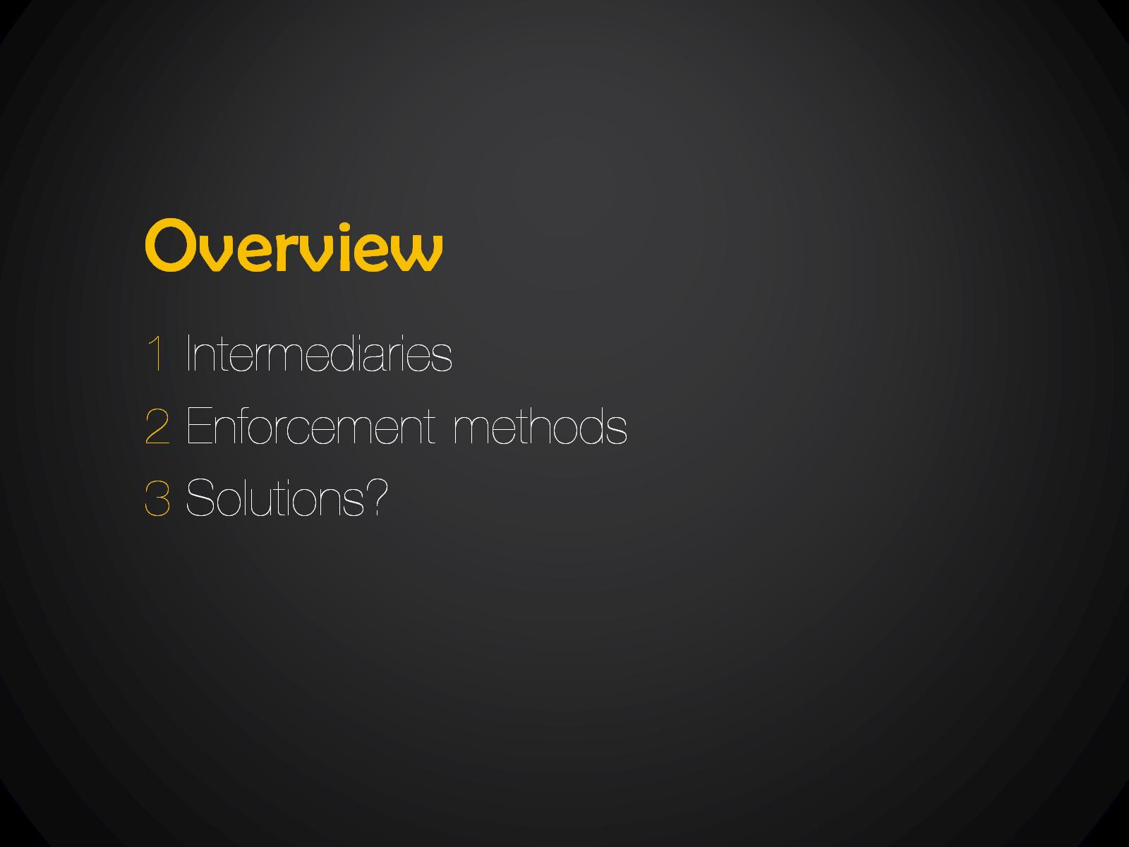
Overview

Slide 10


Slide 11


Slide 12


Slide 13


Slide 14


Slide 15


Slide 16


Slide 17


Slide 18
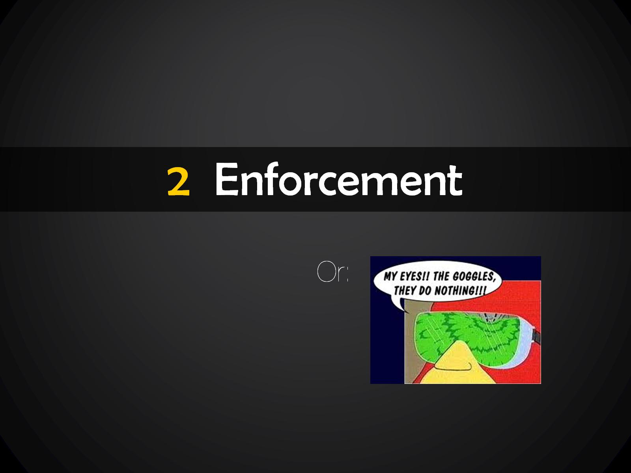

Slide 19


Slide 20


Slide 21
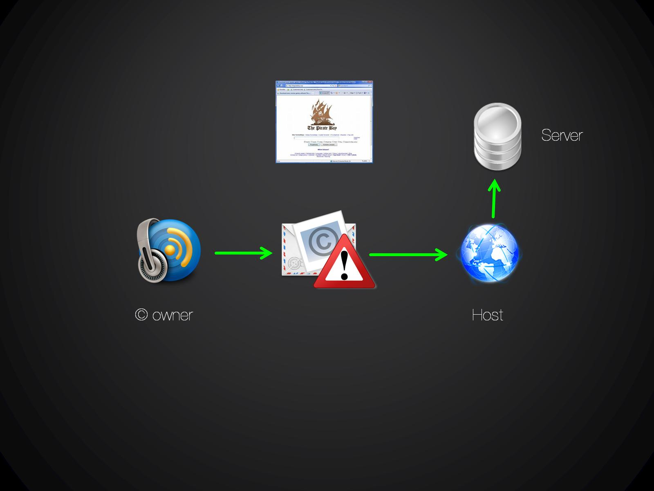

Slide 22
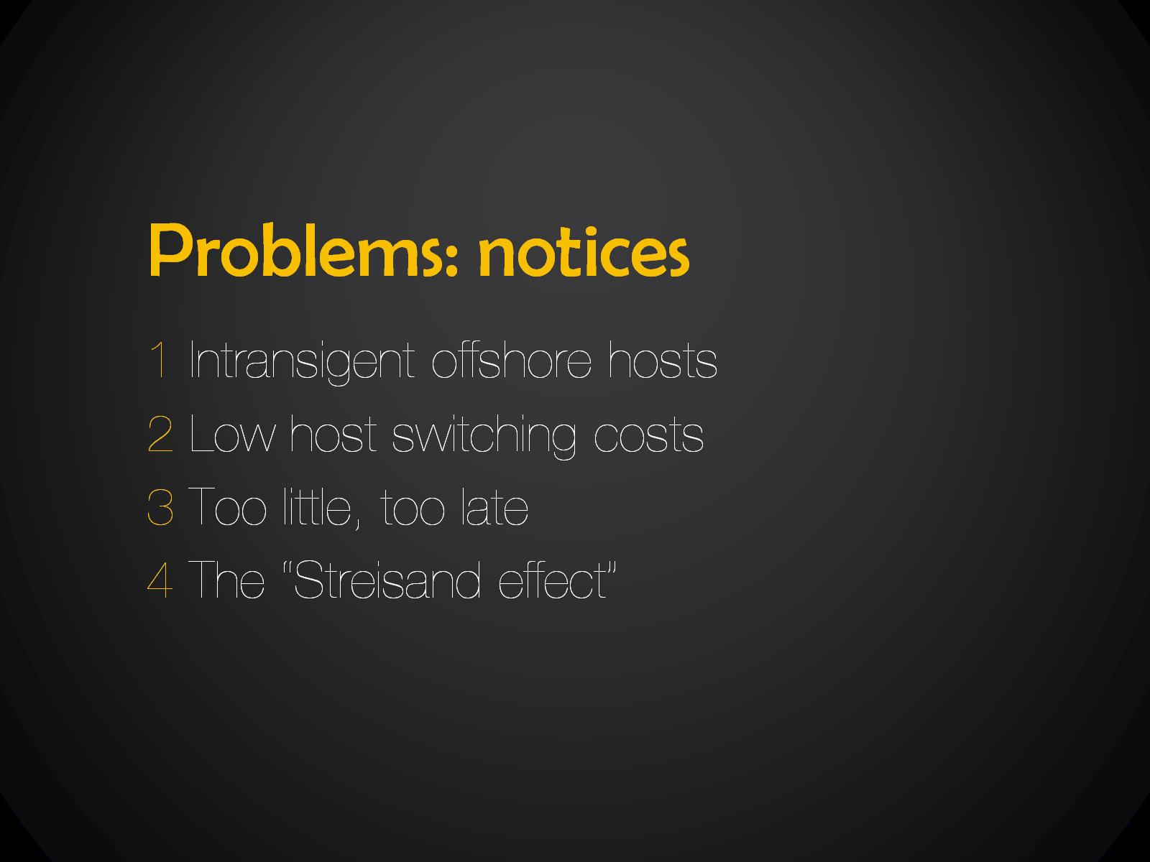
Problems: notices

Slide 23
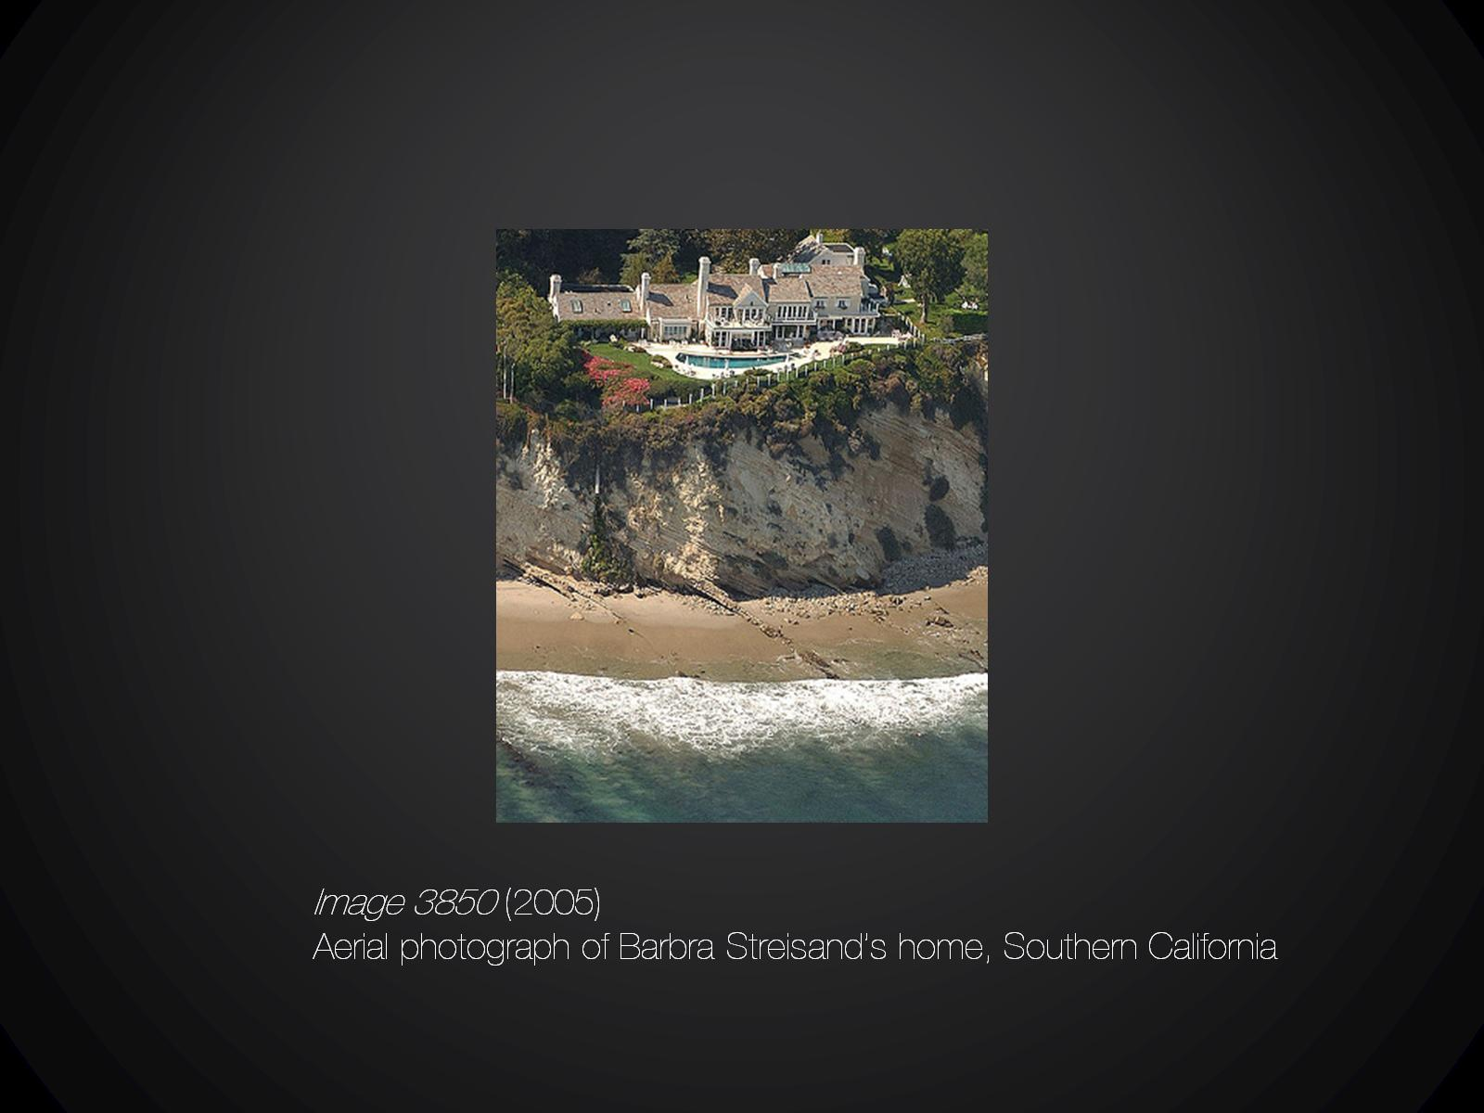

Slide 24
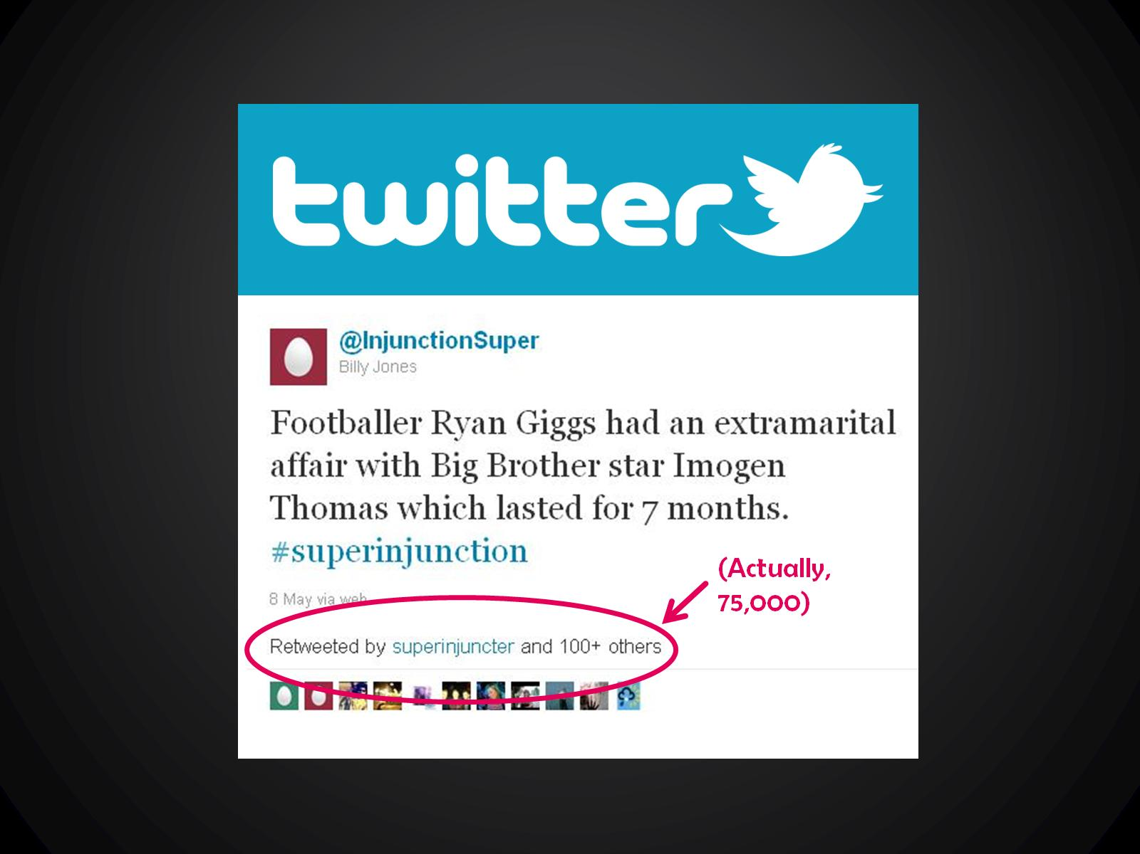

Slide 25


Slide 26
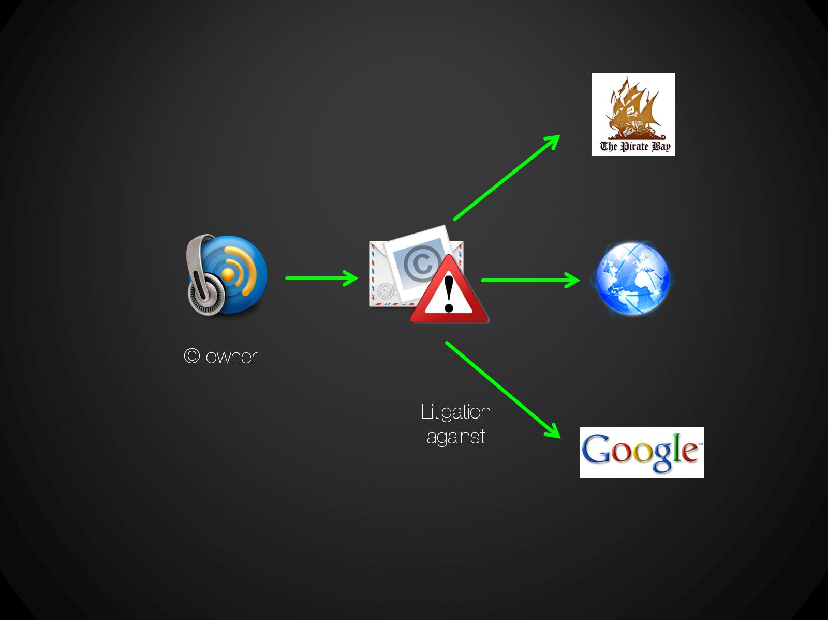

Slide 27


Slide 28
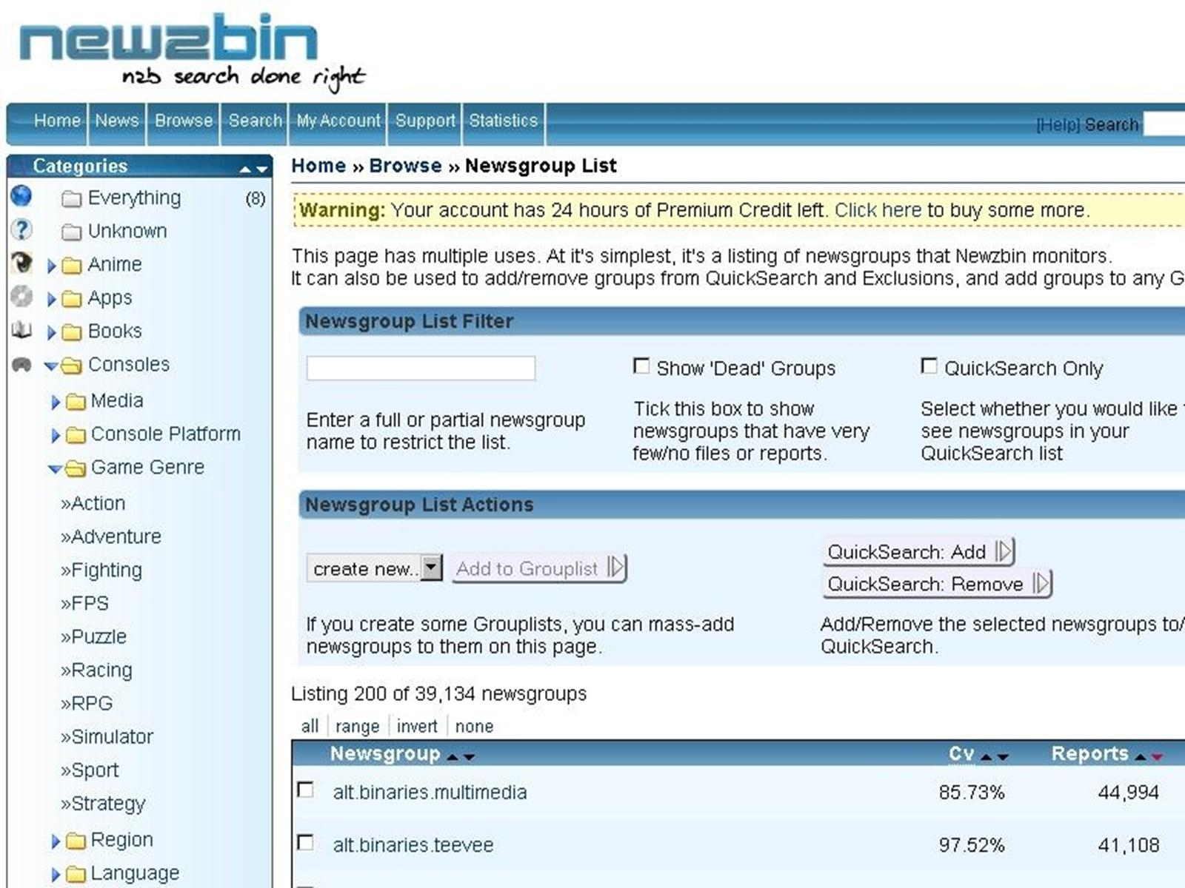

Slide 29
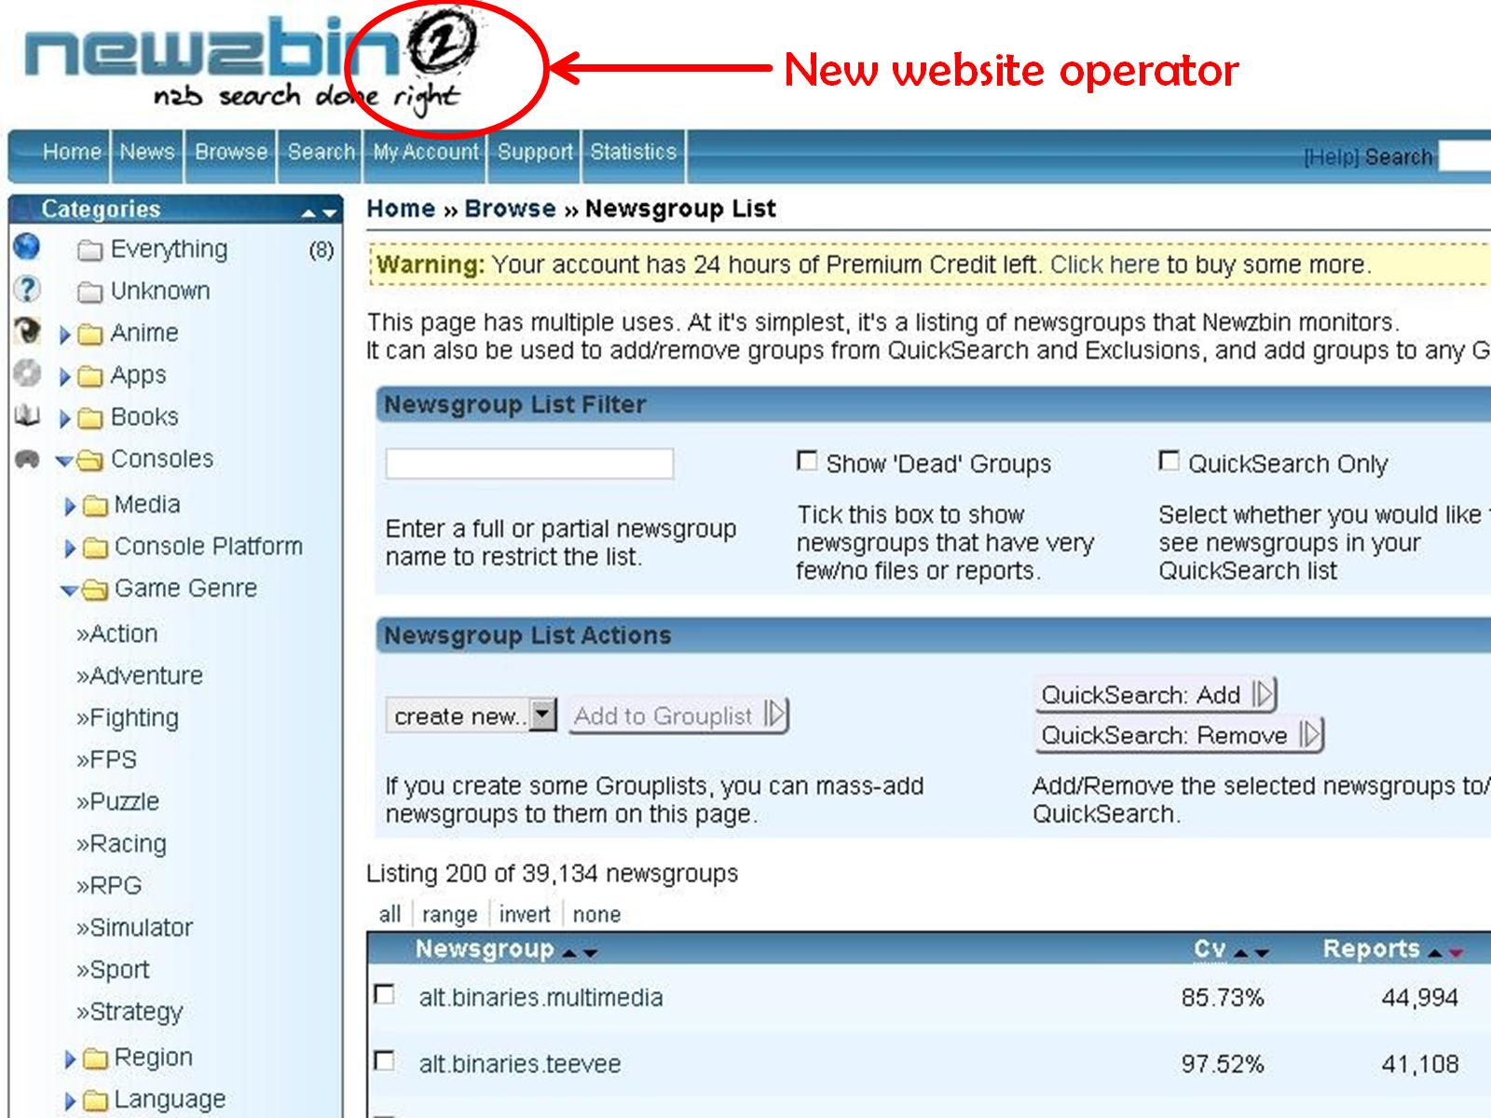

Slide 30
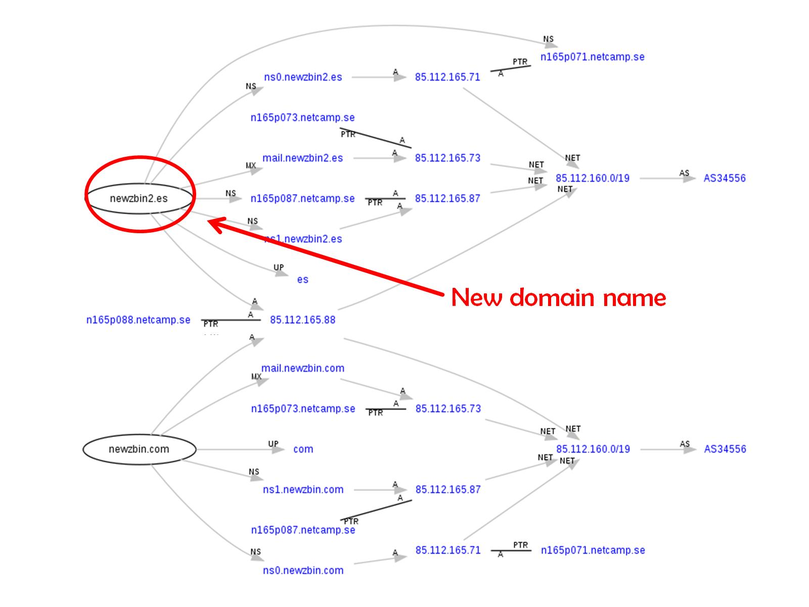

Slide 31
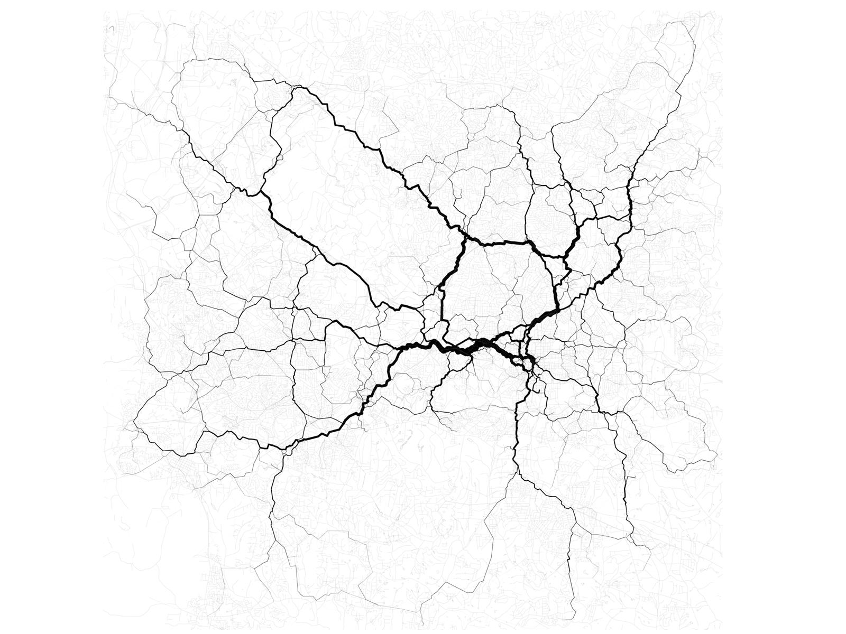

Slide 32
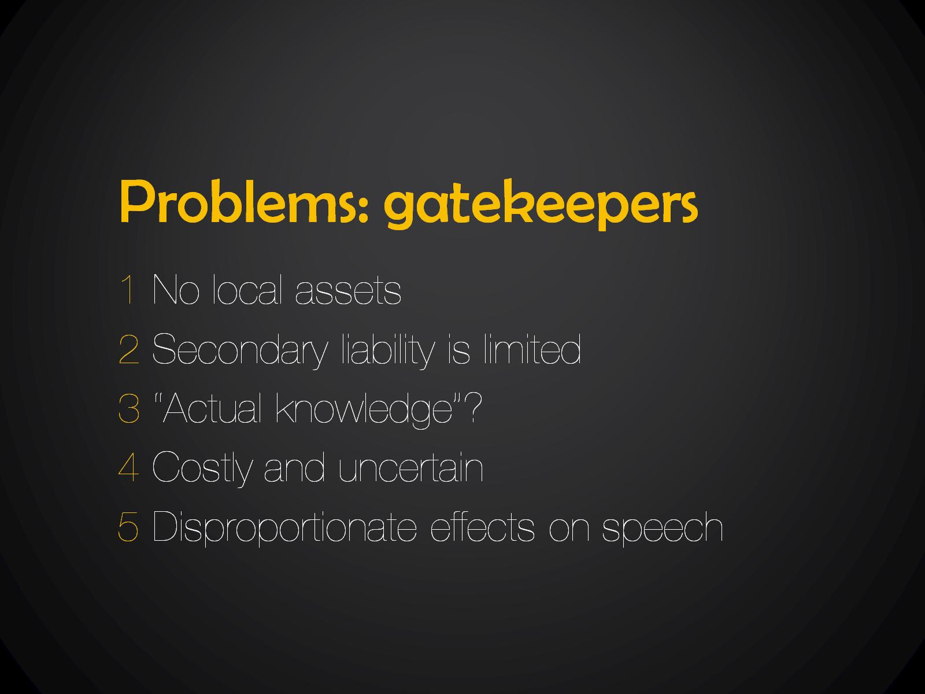
Problems: gatekeepers

Slide 33


Slide 34


Slide 35
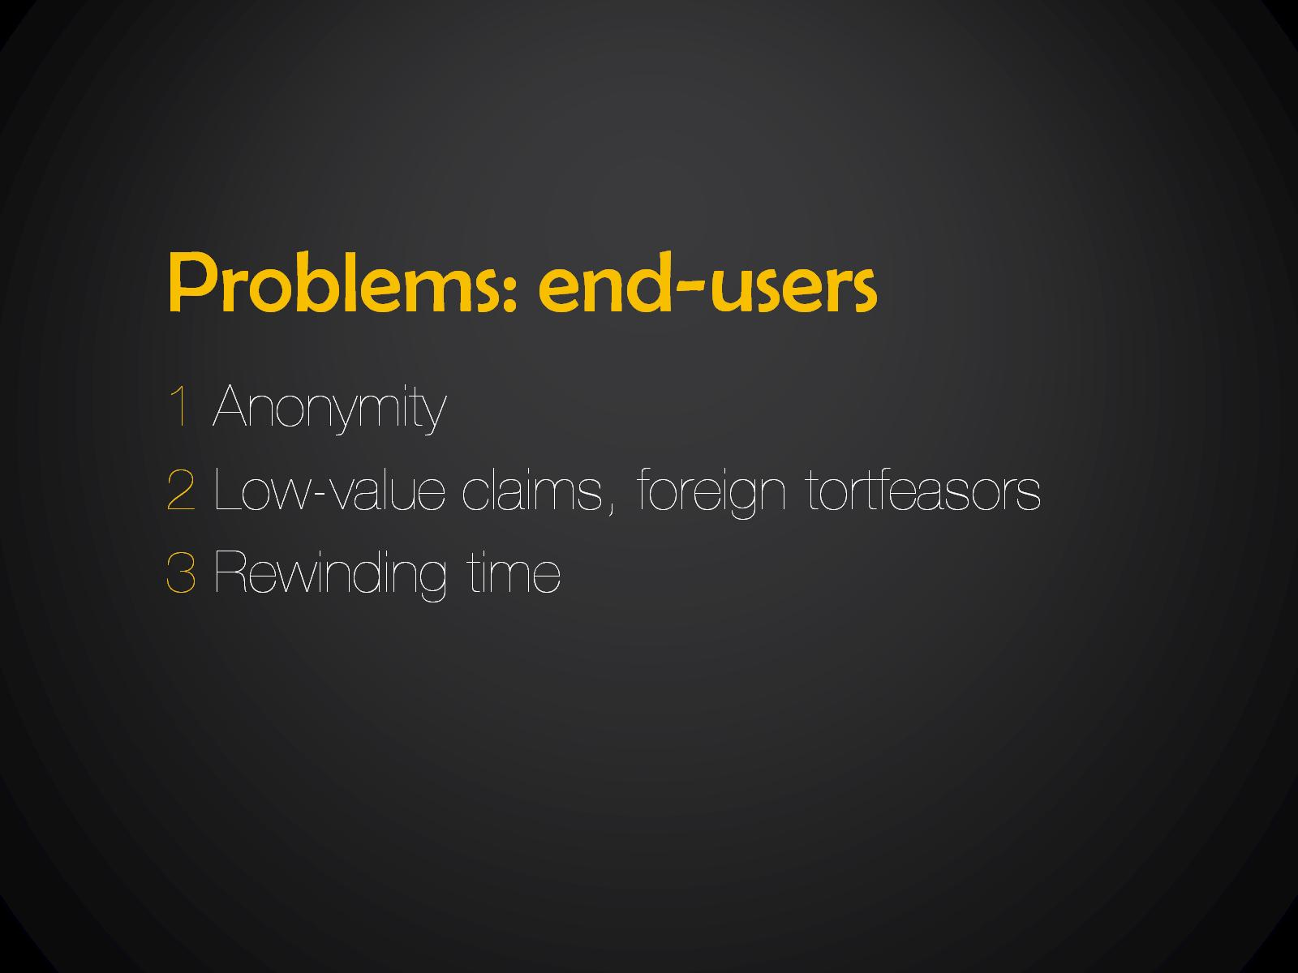
Problems: end-users

Slide 36


Slide 37


Slide 38
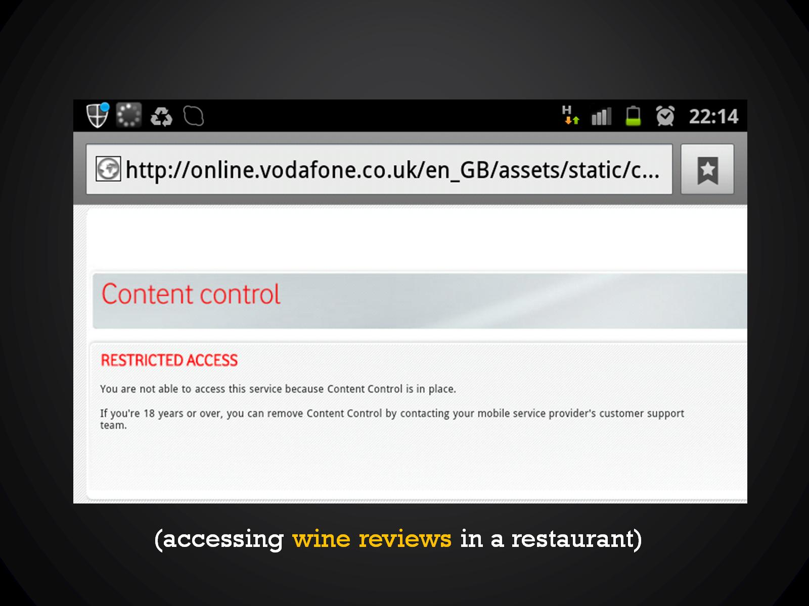

Slide 39


Slide 40
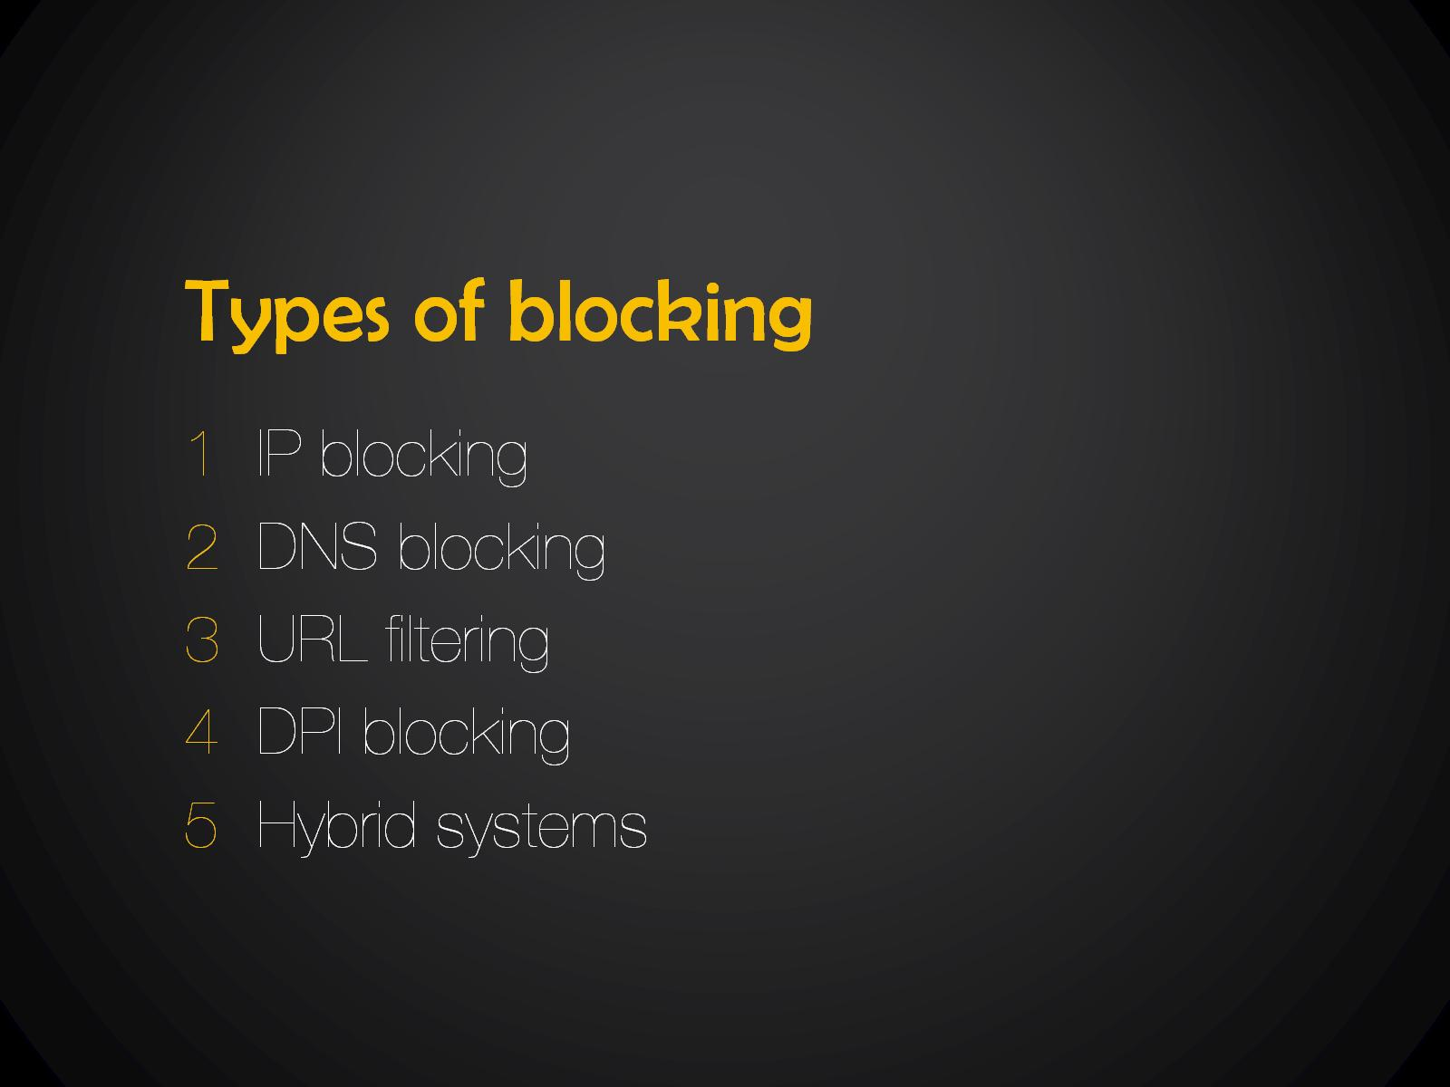
Types of blocking

Slide 41

circumvention

Slide 42
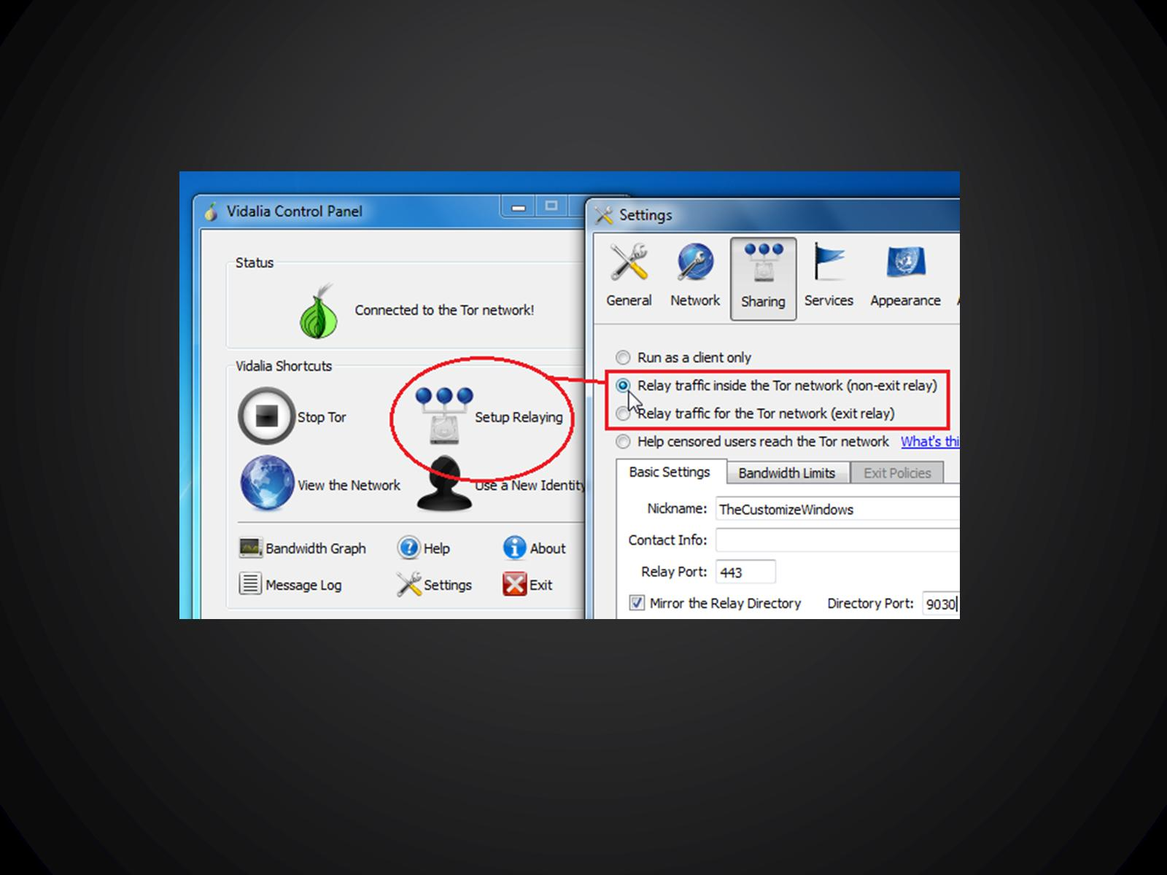

Slide 43
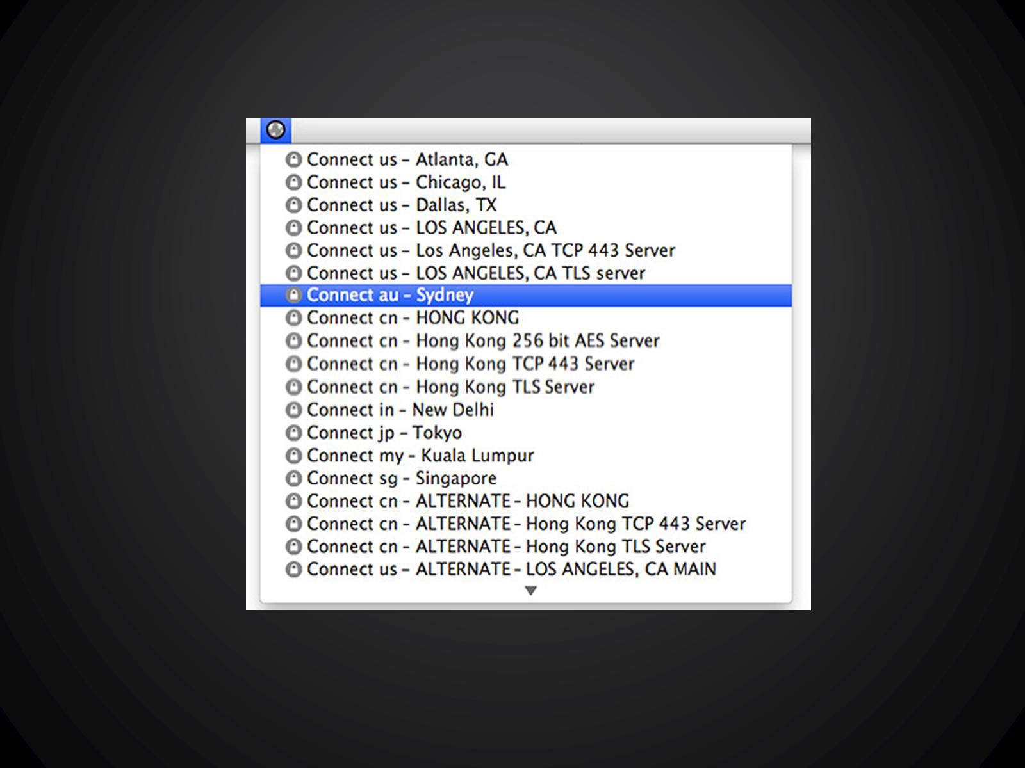

Slide 44
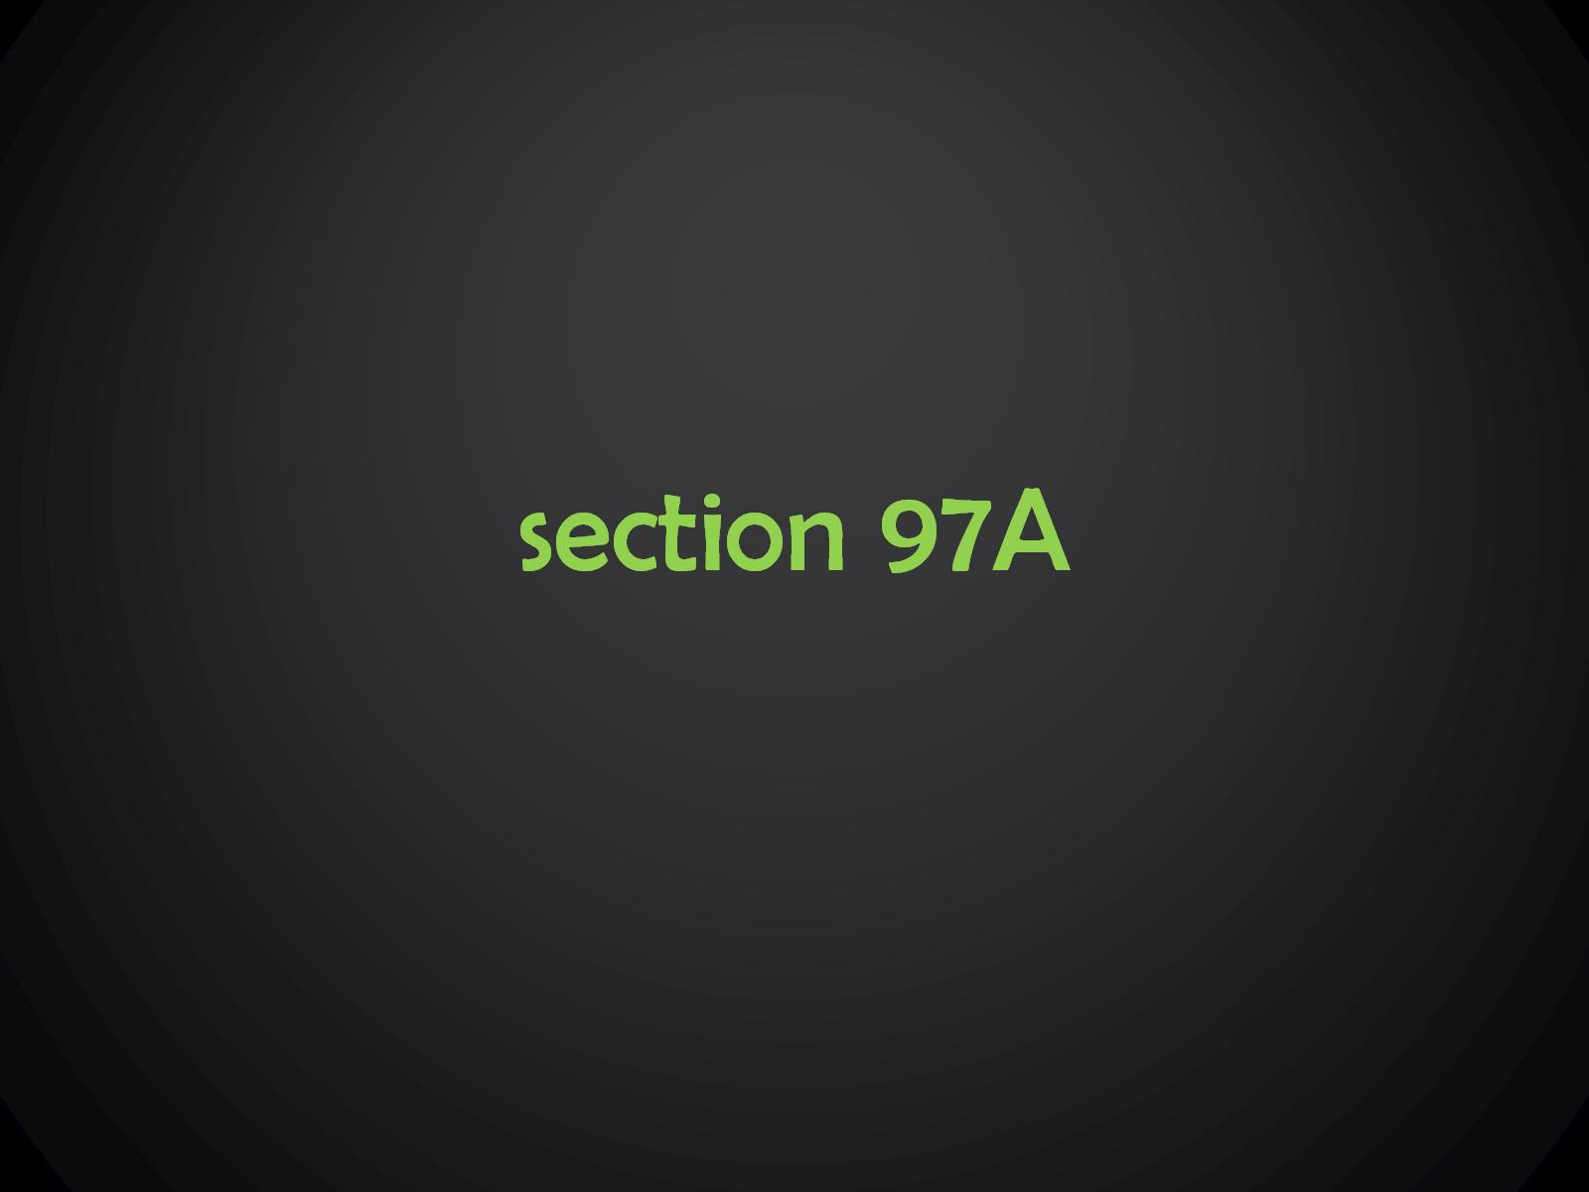
section 97A

Slide 45
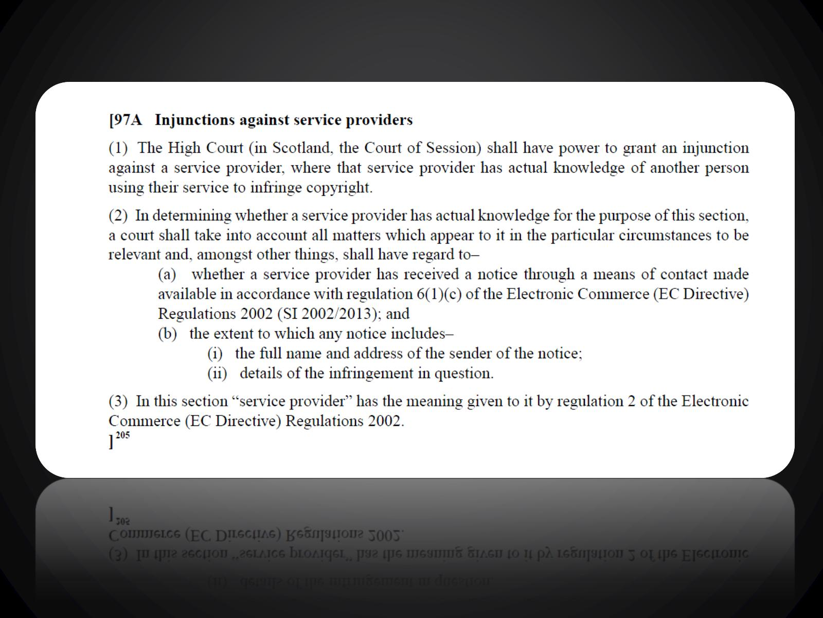

Slide 46

actual knowledge =

Slide 47
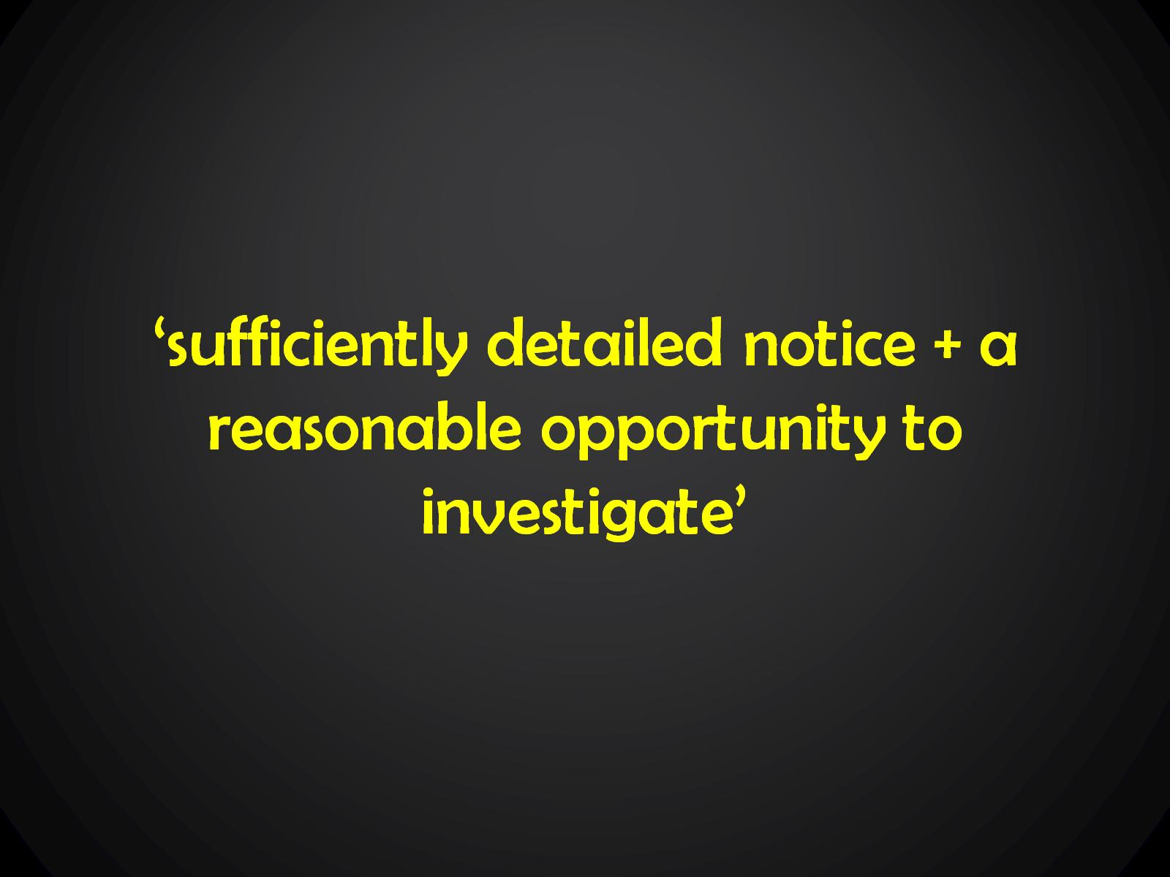
‘sufficiently detailed notice + a reasonable opportunity to investigate’

Slide 48
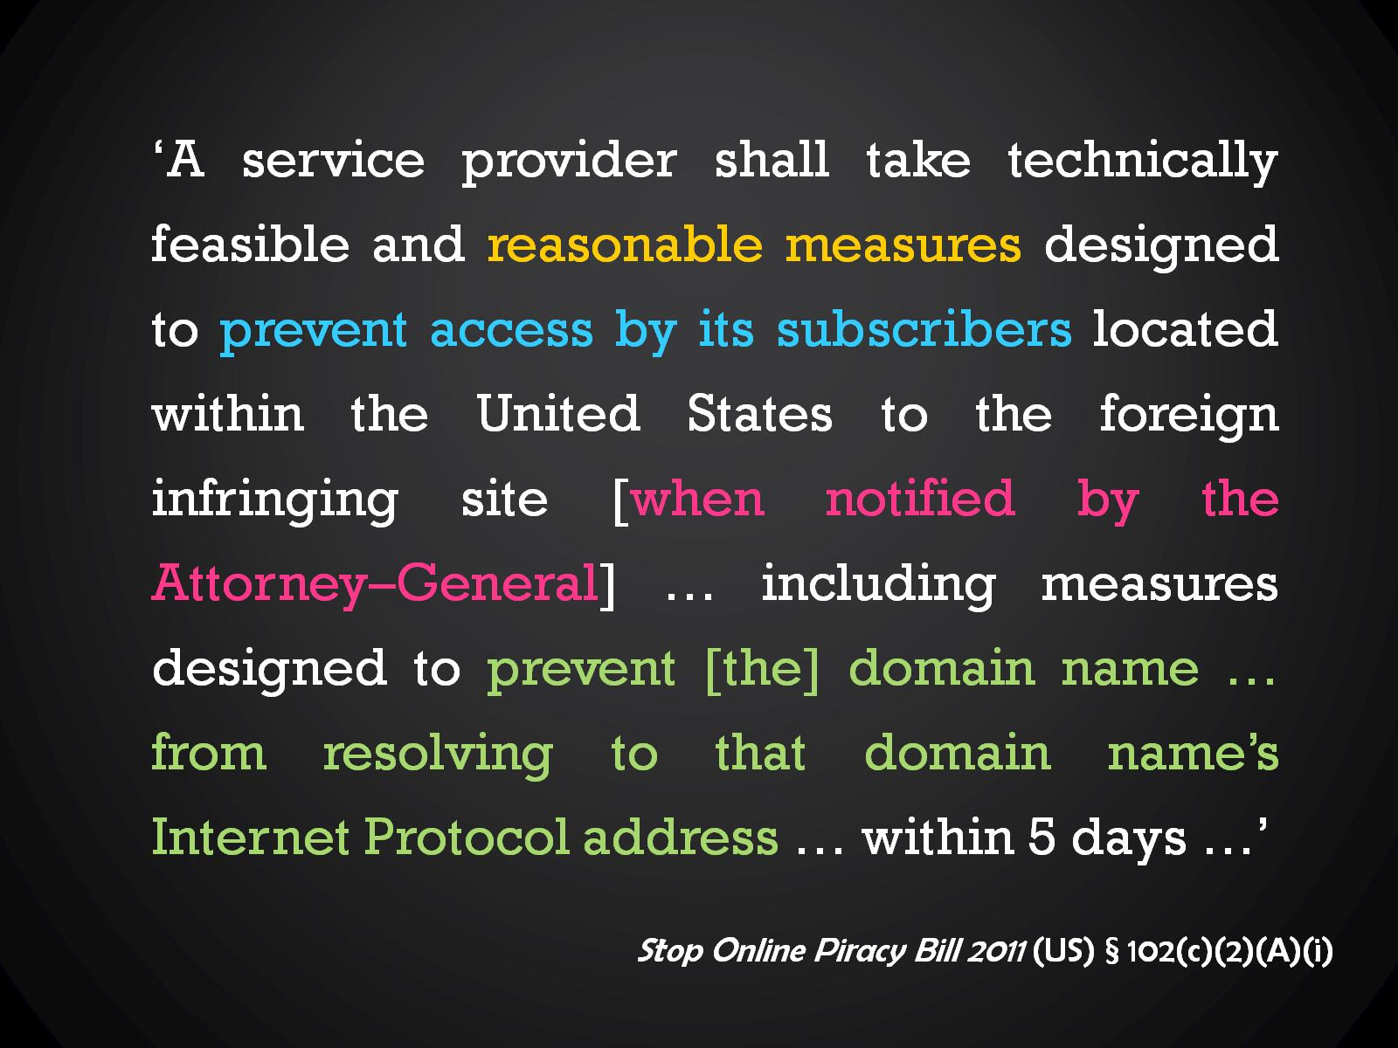

Slide 49
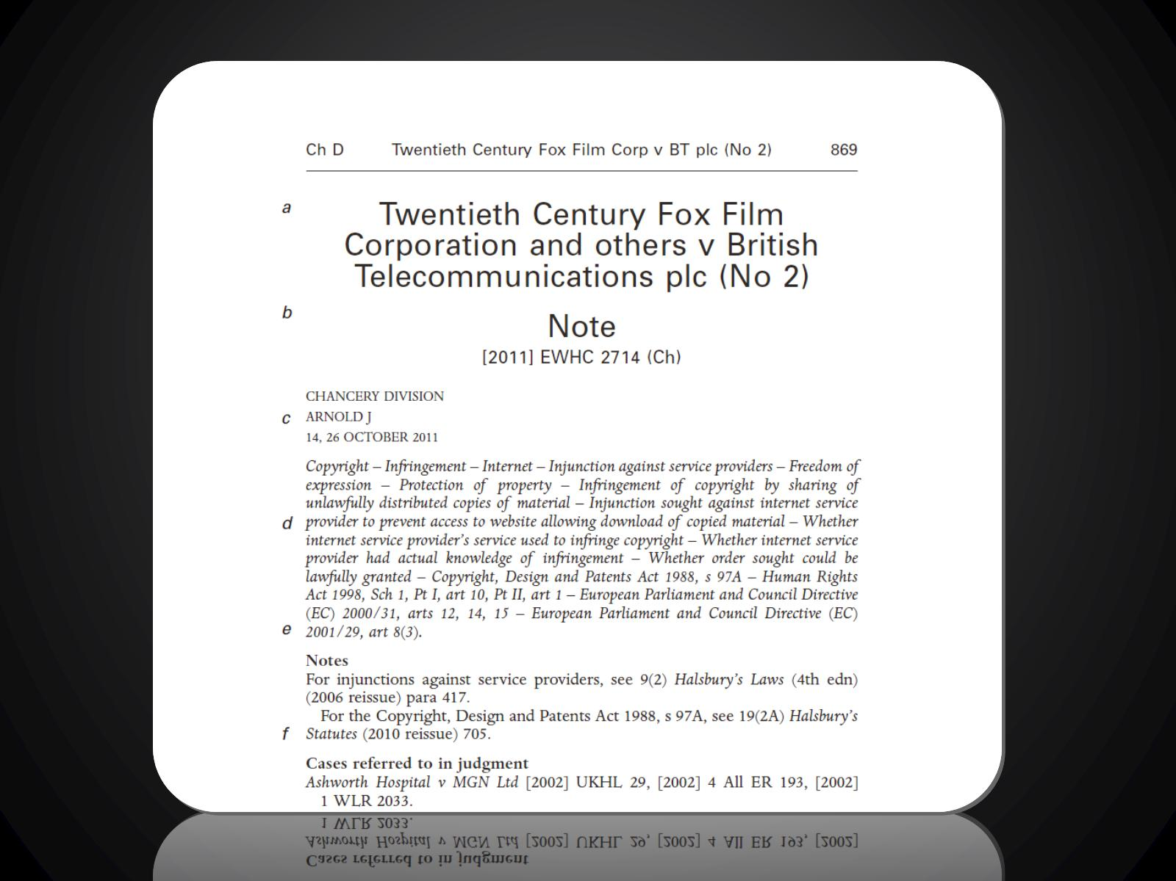

Slide 50
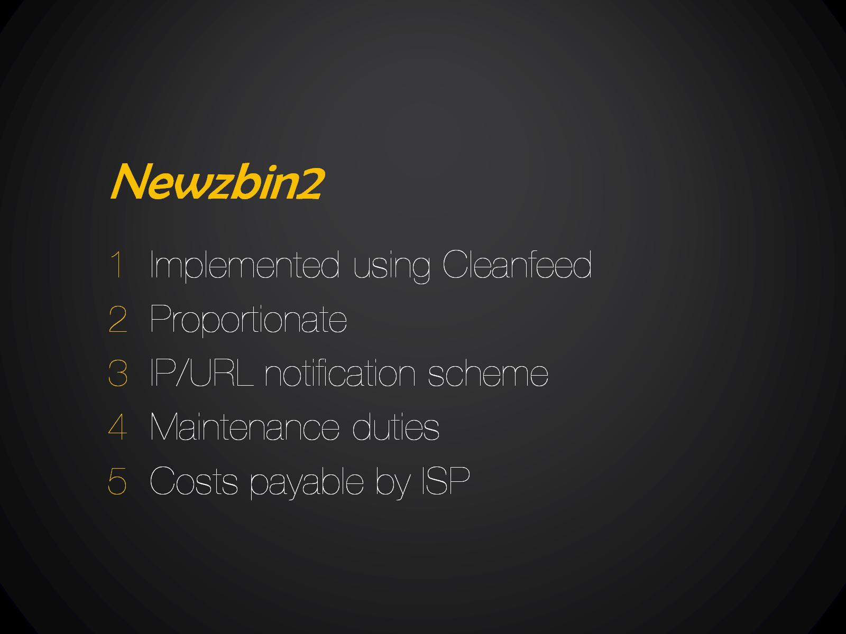
Newzbin2

Slide 51


Slide 52


Slide 53
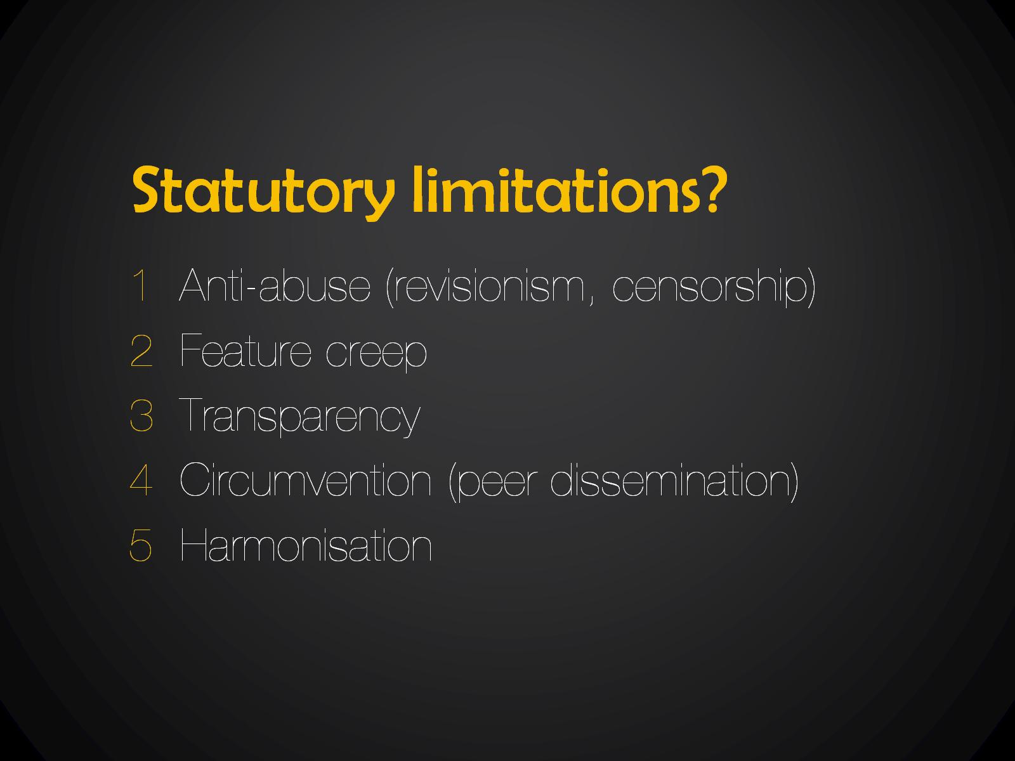
Statutory limitations?

Slide 54
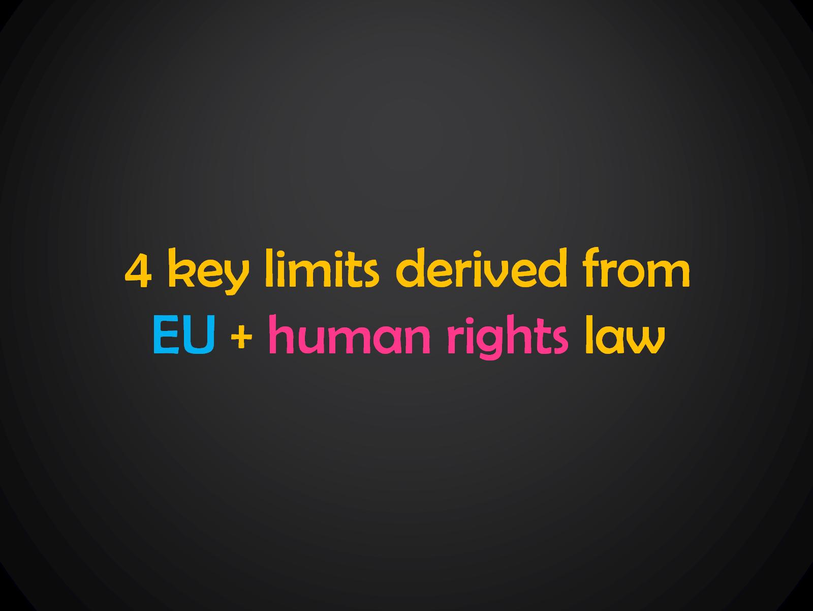
4 key limits derived from EU + human rights law

Slide 55

(i) no general monitoring

Slide 56

(ii) freedom of commerce

Slide 57

(iii) cost & complexity

Slide 58
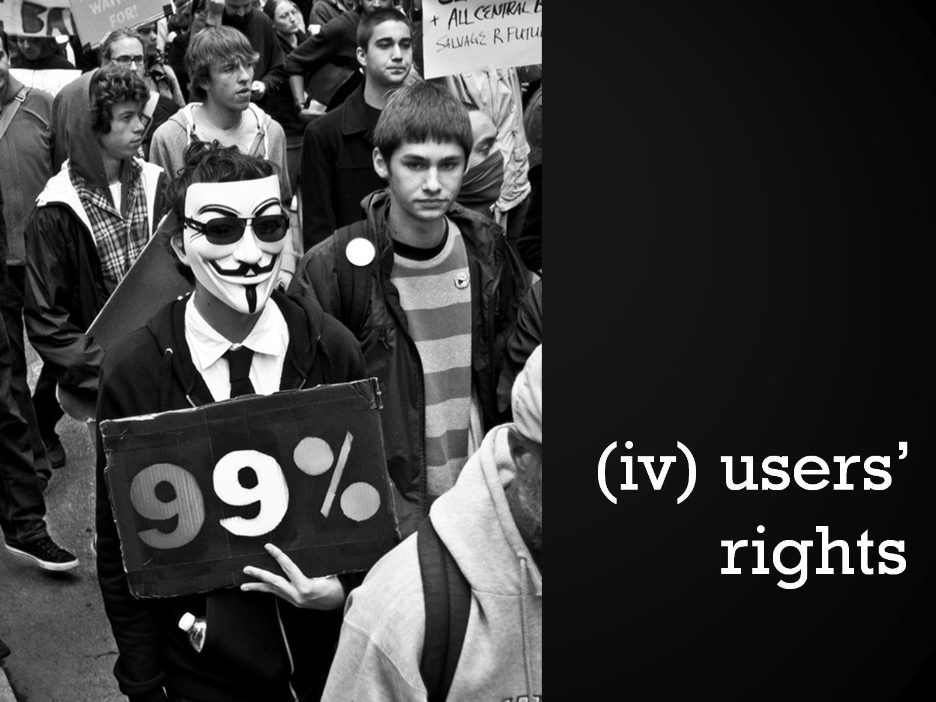
(iv) users’ rights

Slide 59

is blocking effective?

Slide 60
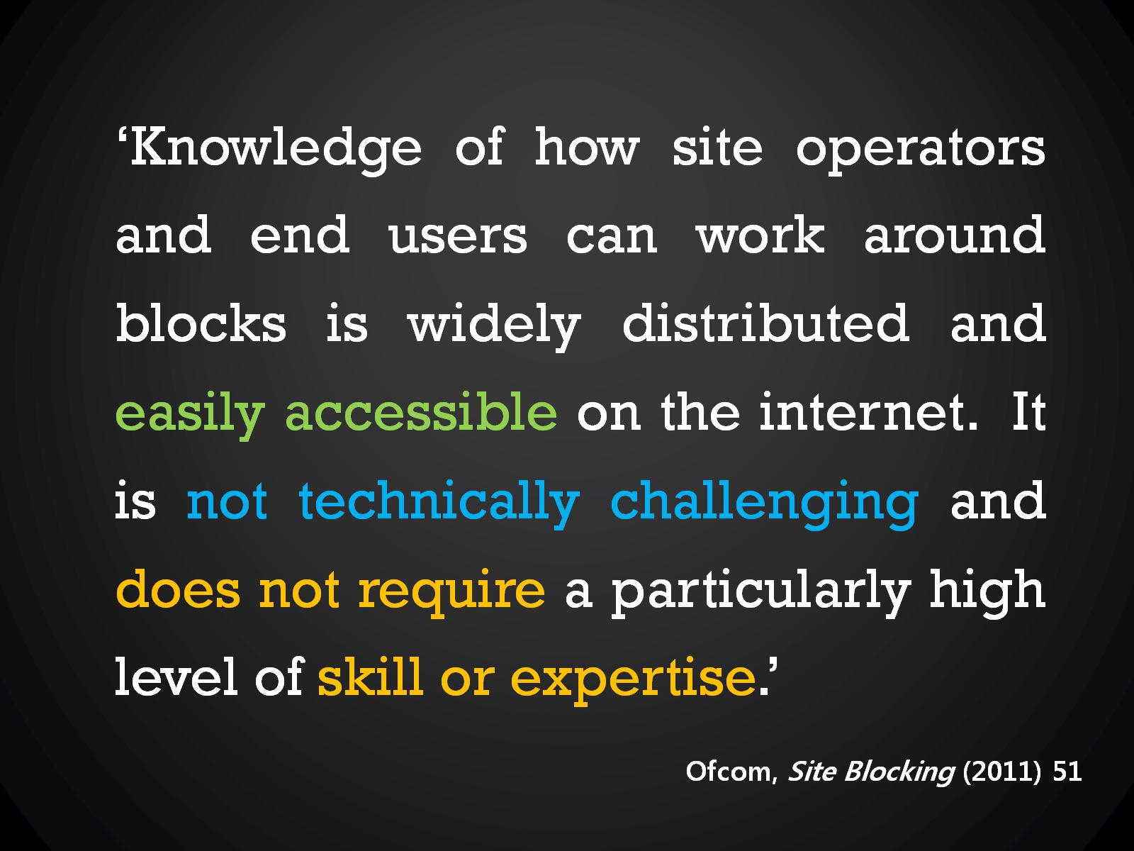

Slide 61
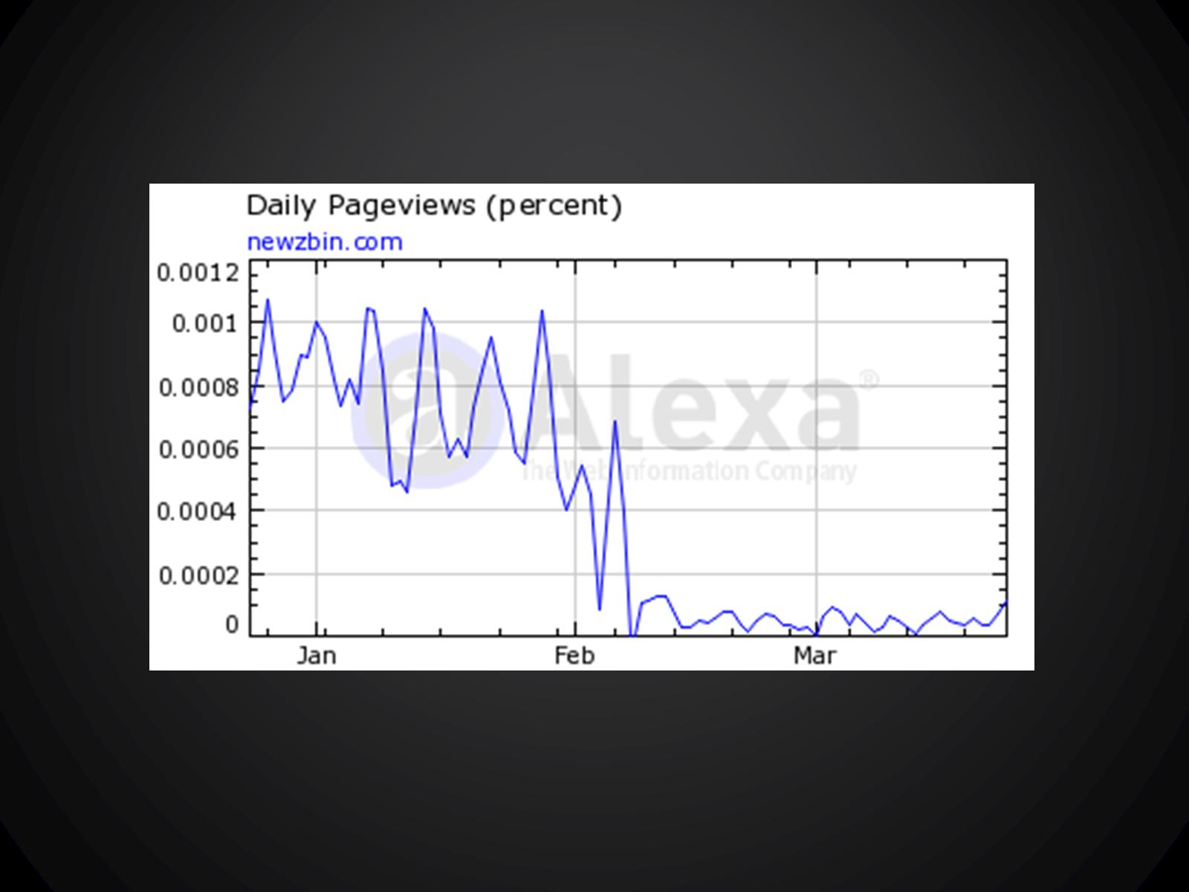

Slide 62
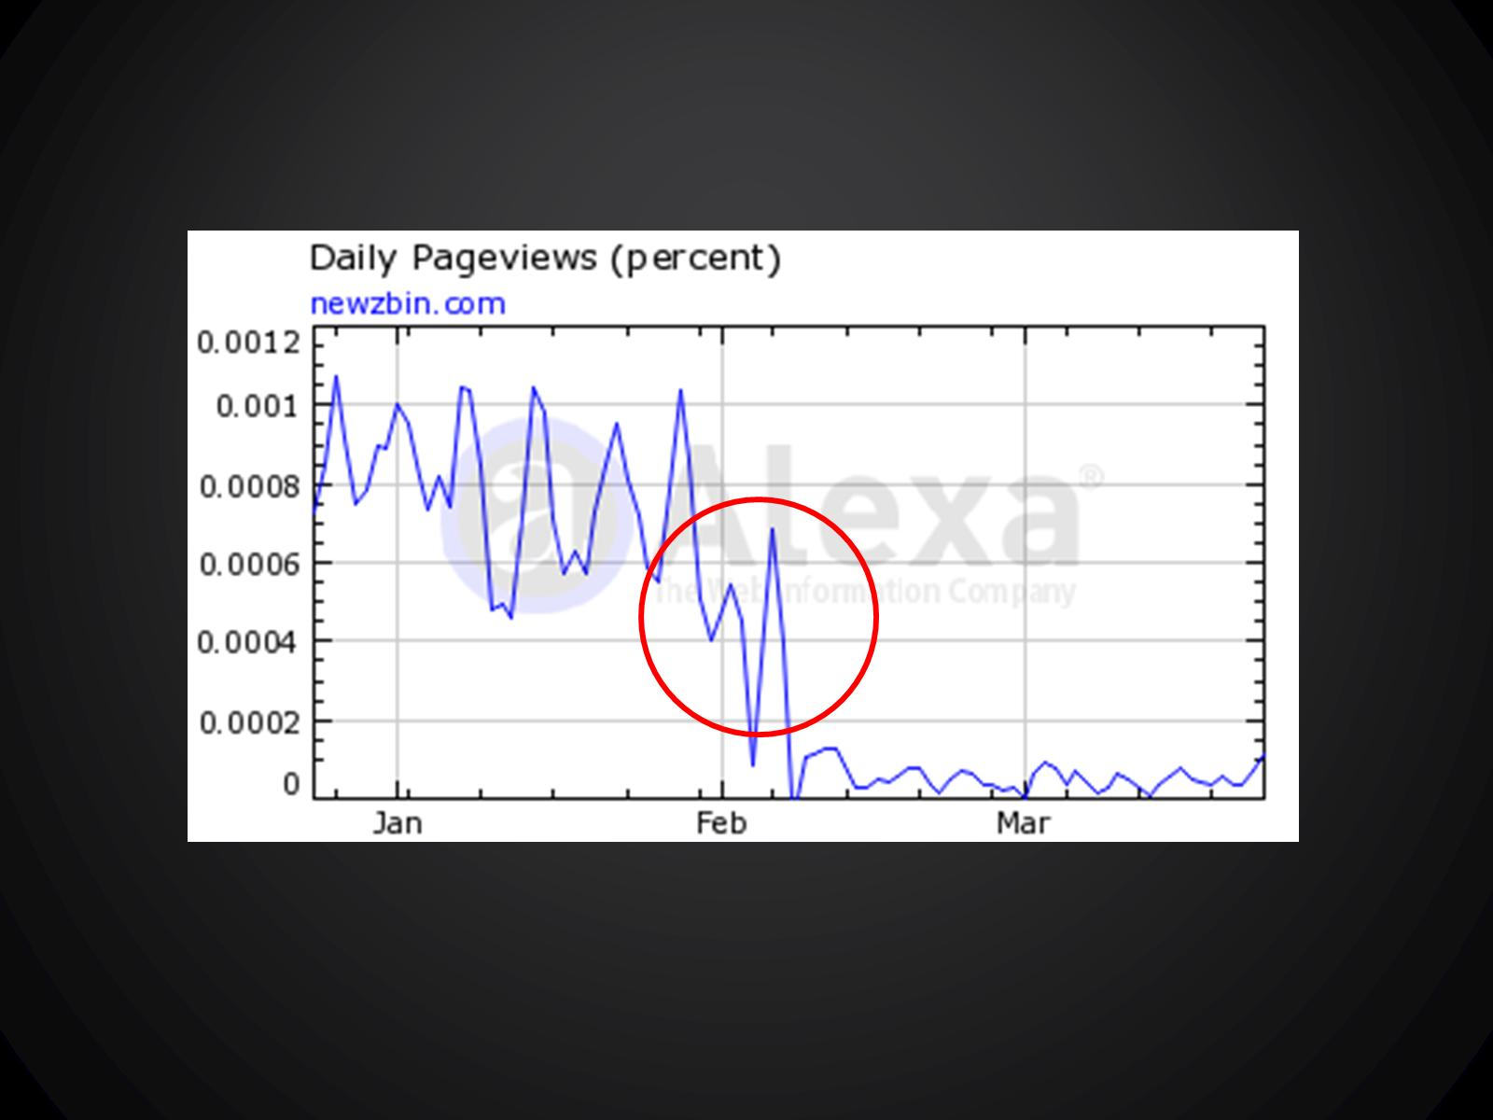

Slide 63
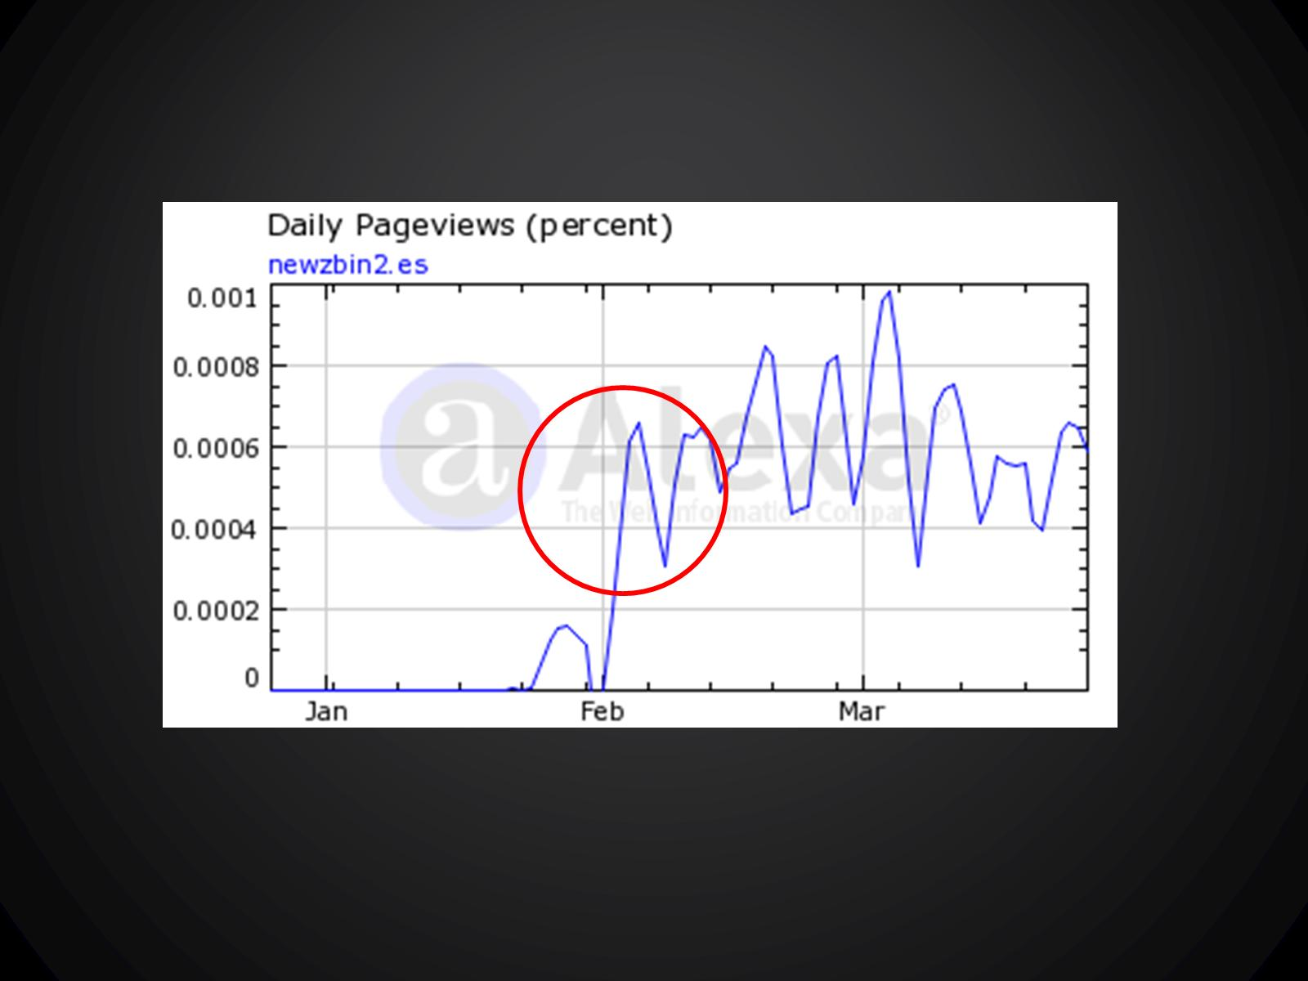

Slide 64
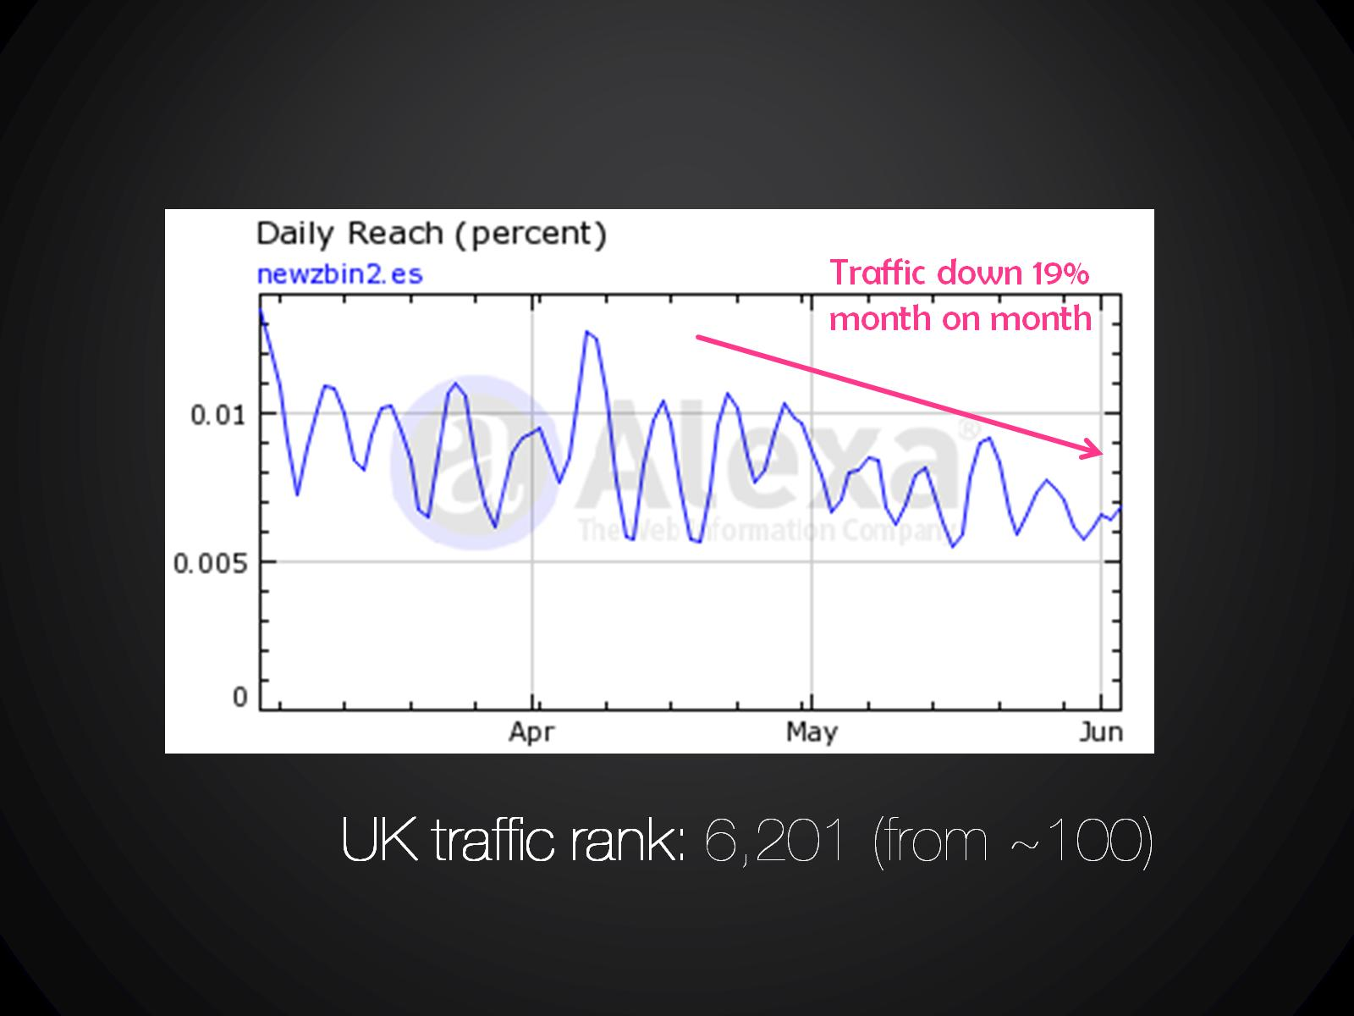

Slide 65
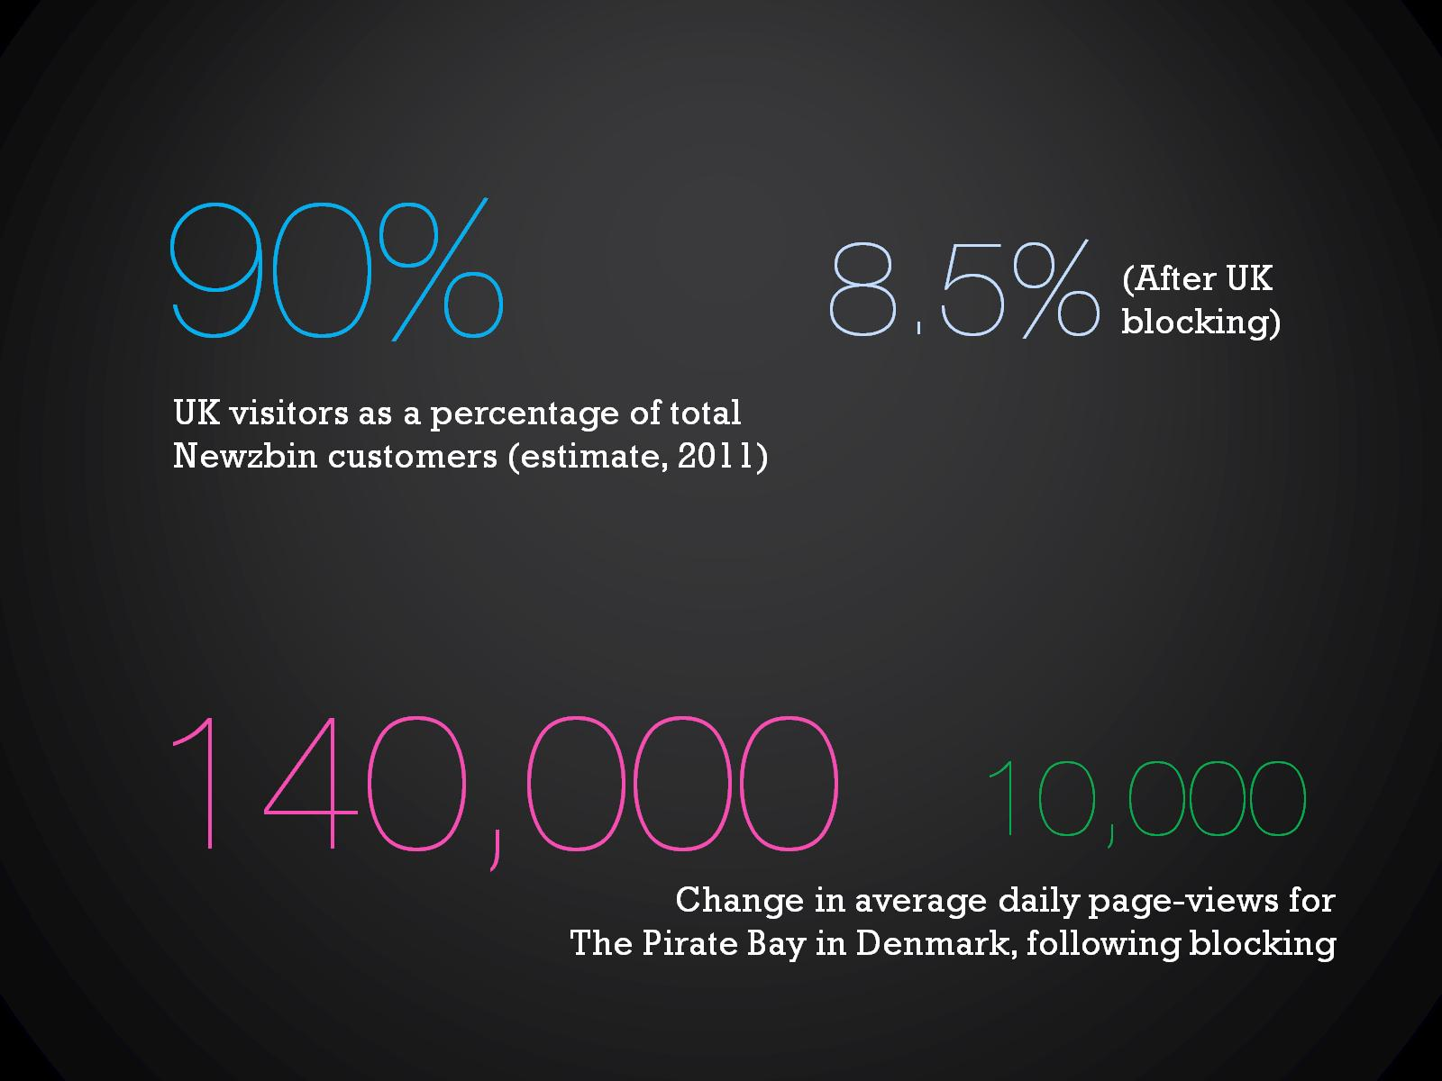

Slide 66
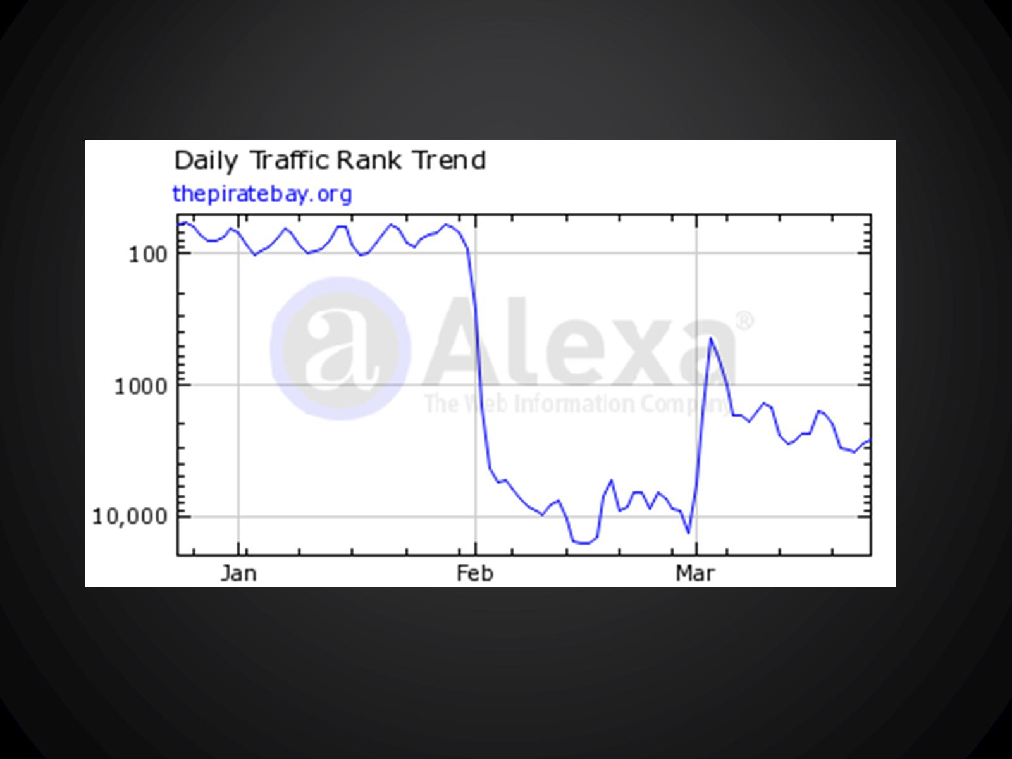

Slide 67
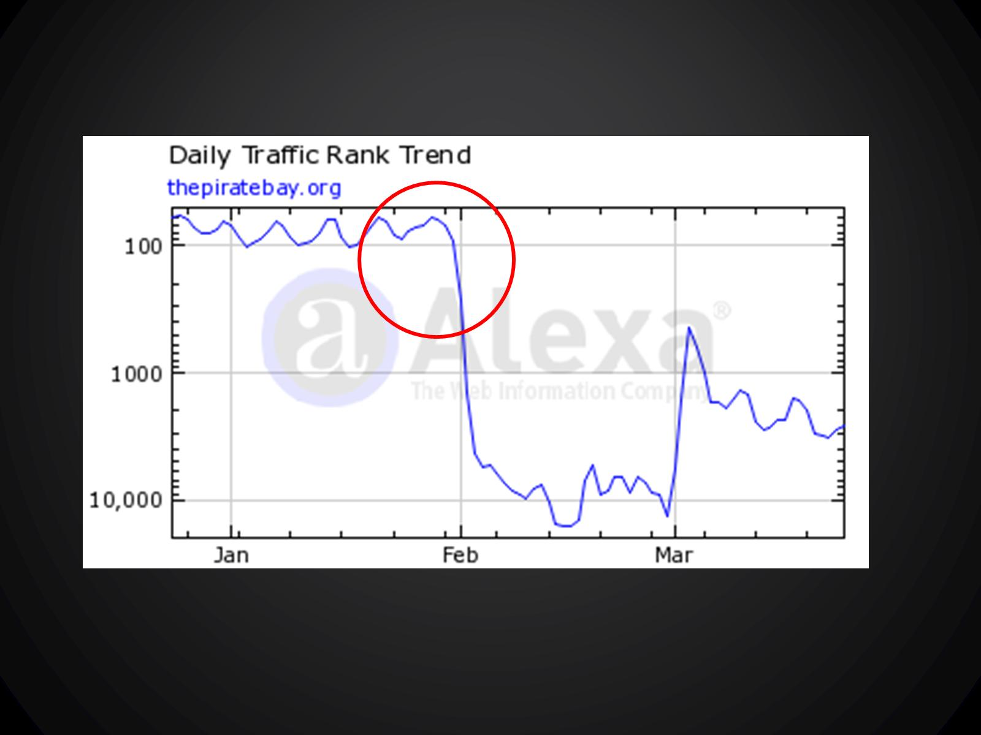

Slide 68
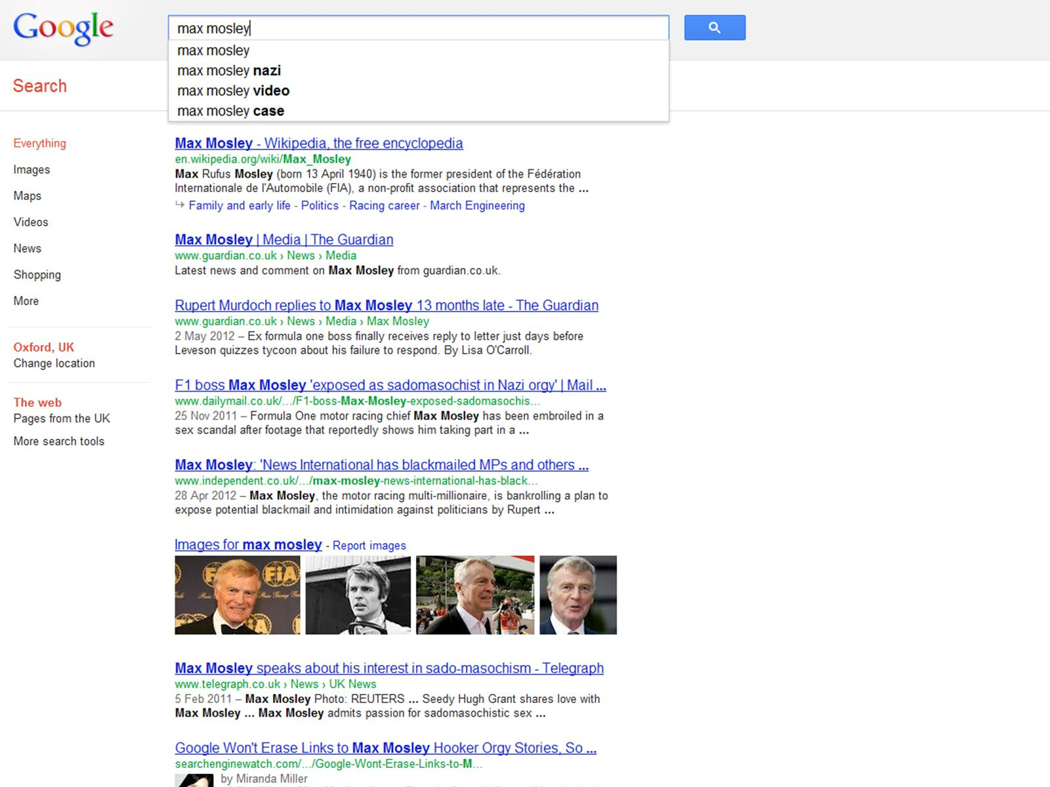

Slide 69
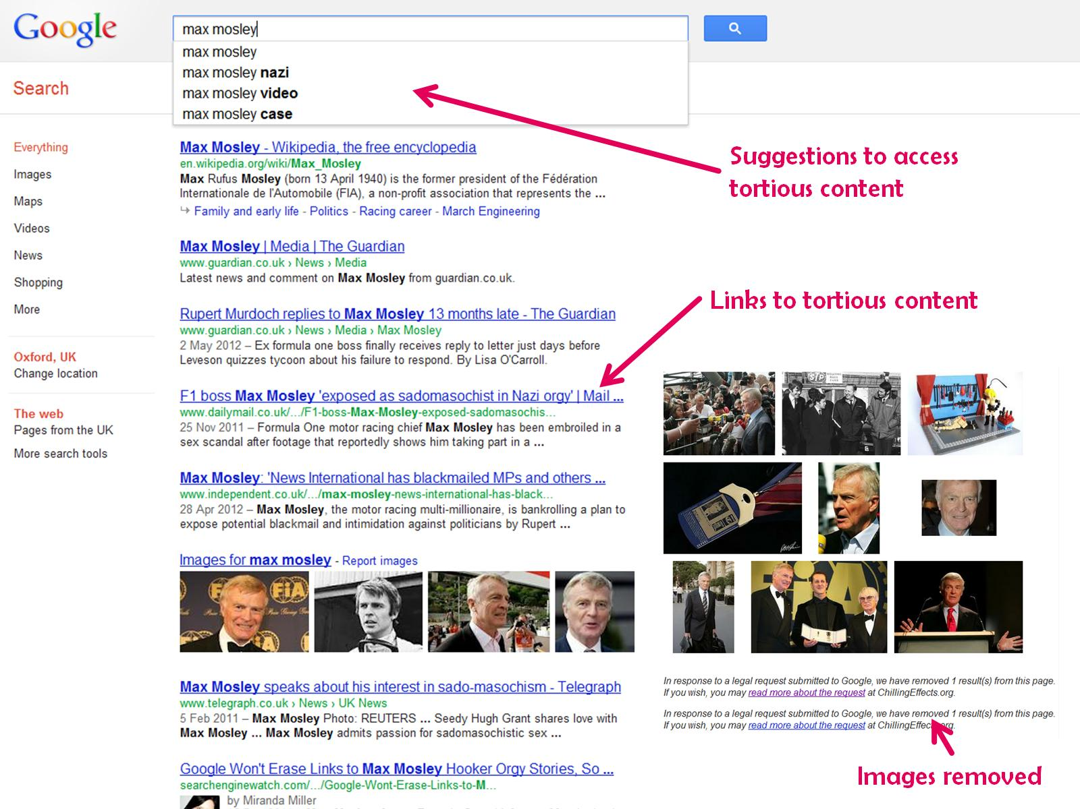

Slide 70
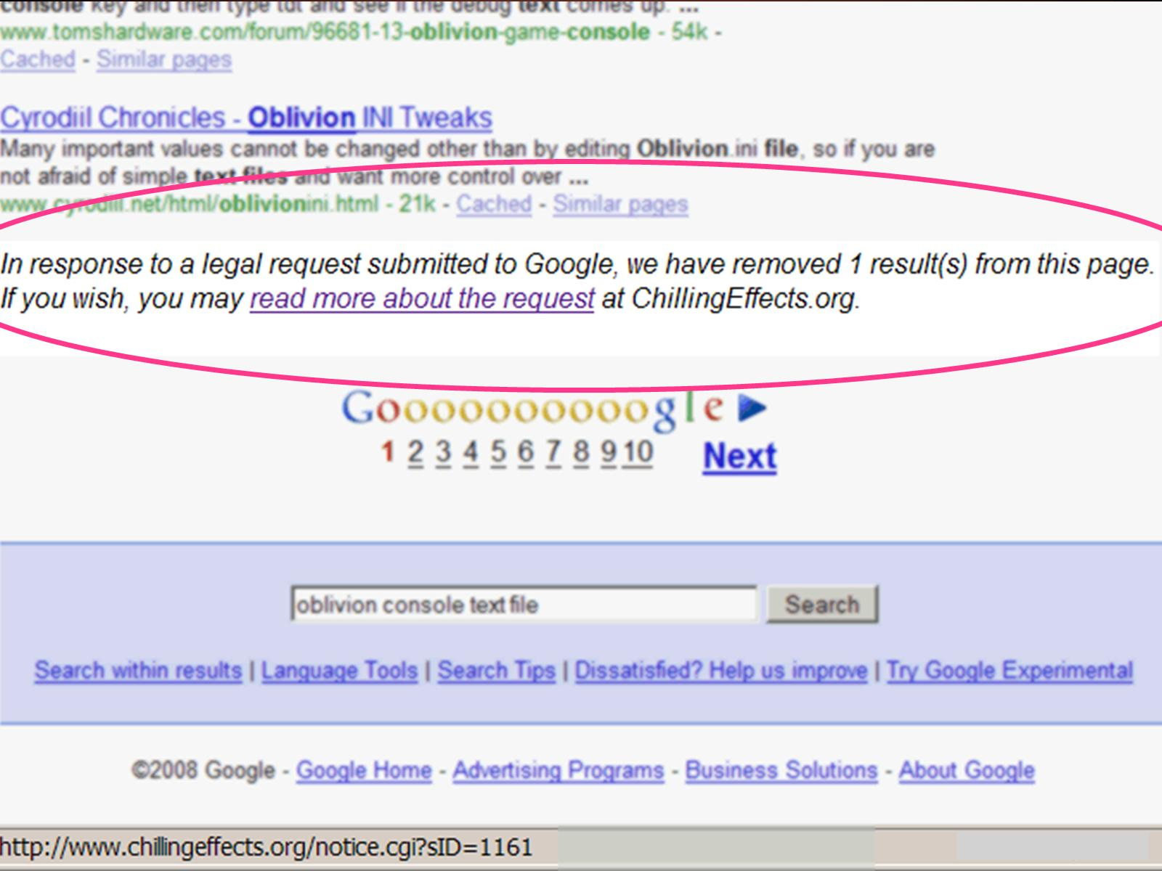

Slide 71
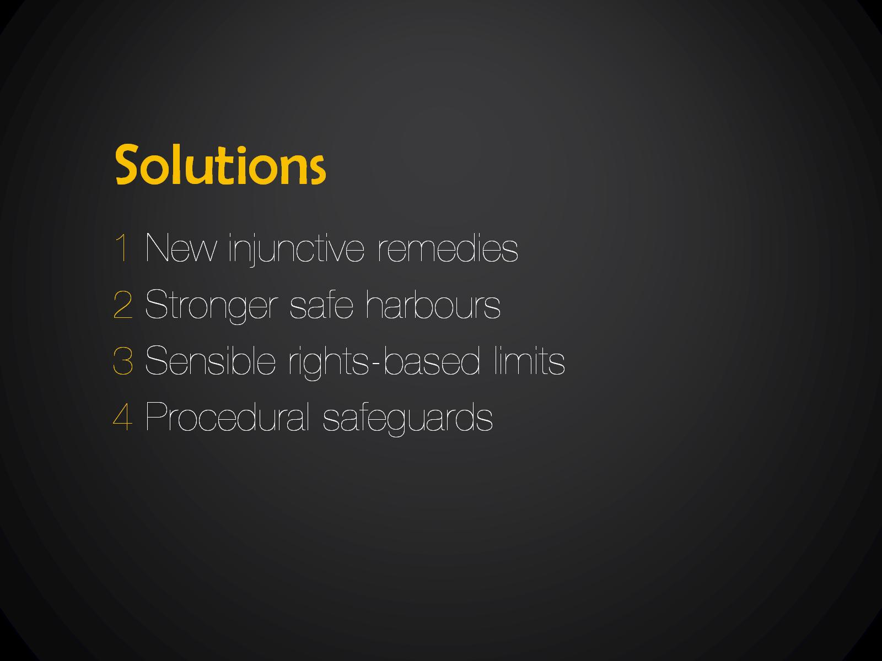
Solutions

Slide 72


Slide 73


Slide 74
Solutions

Slide 75
The law of website blocking

